Slide 1
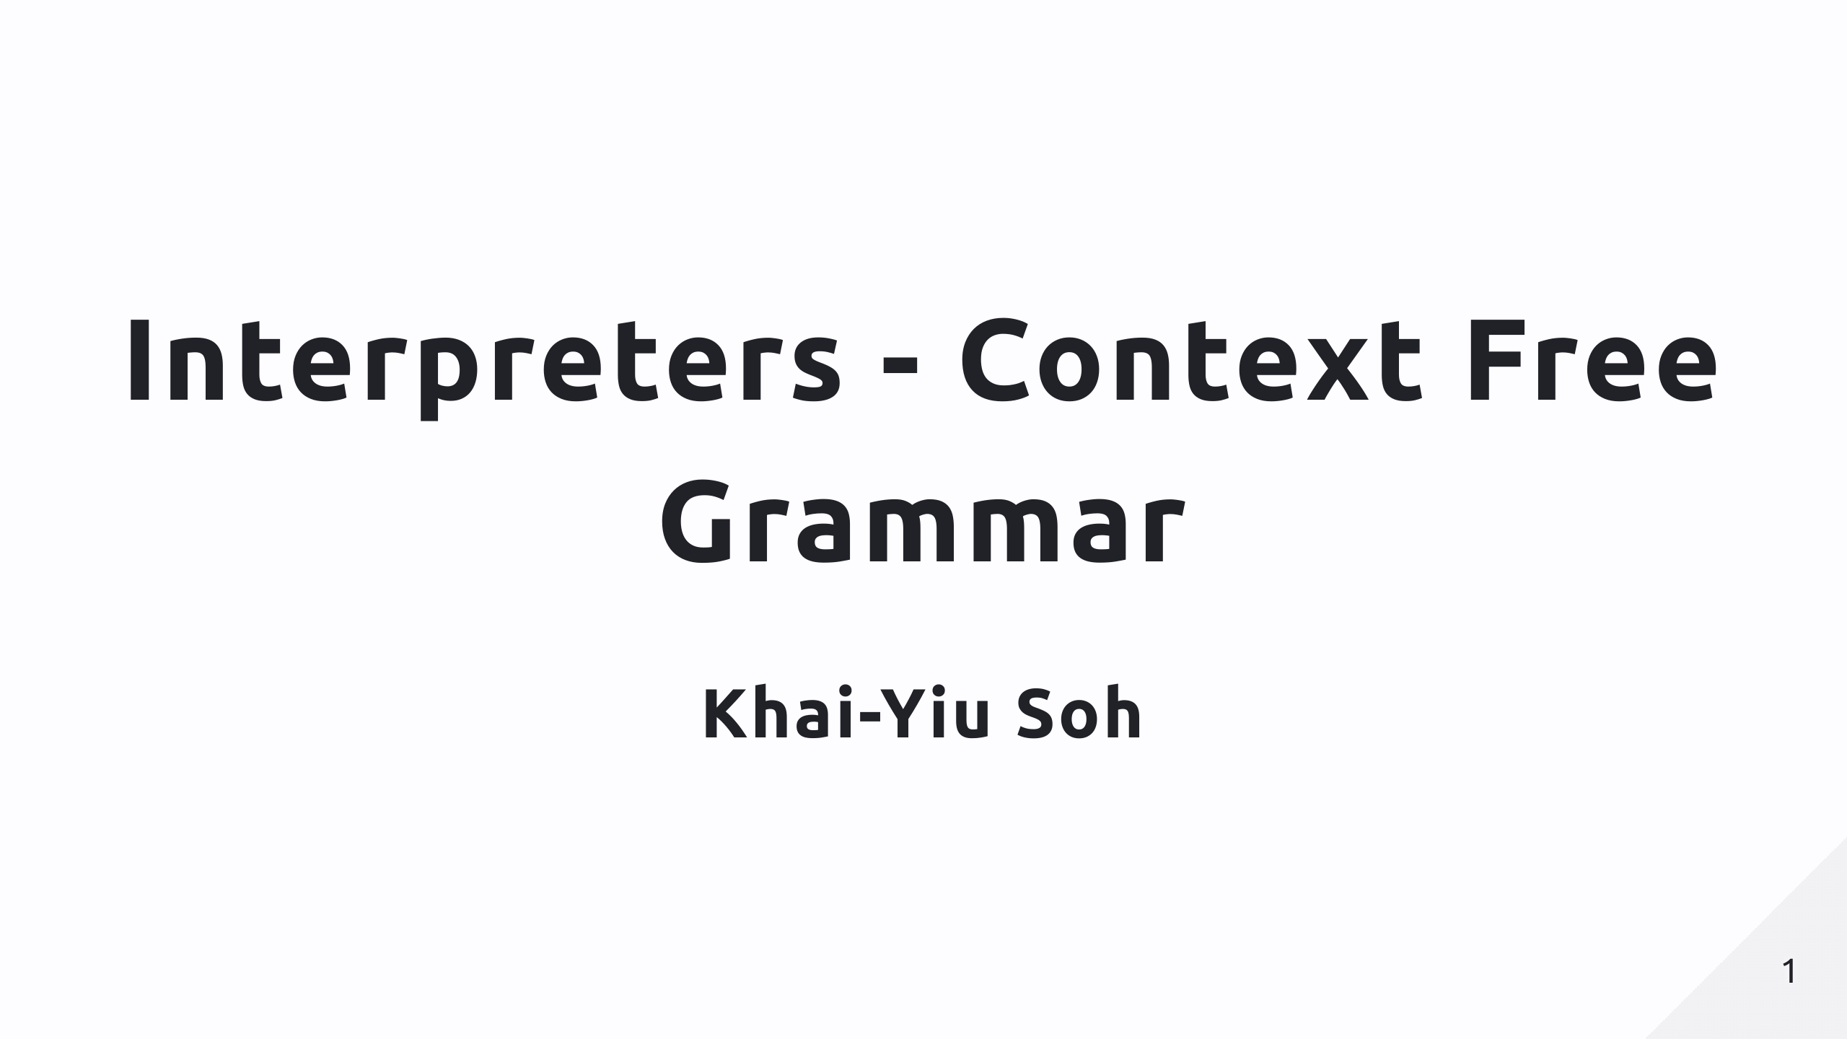

Slide 2
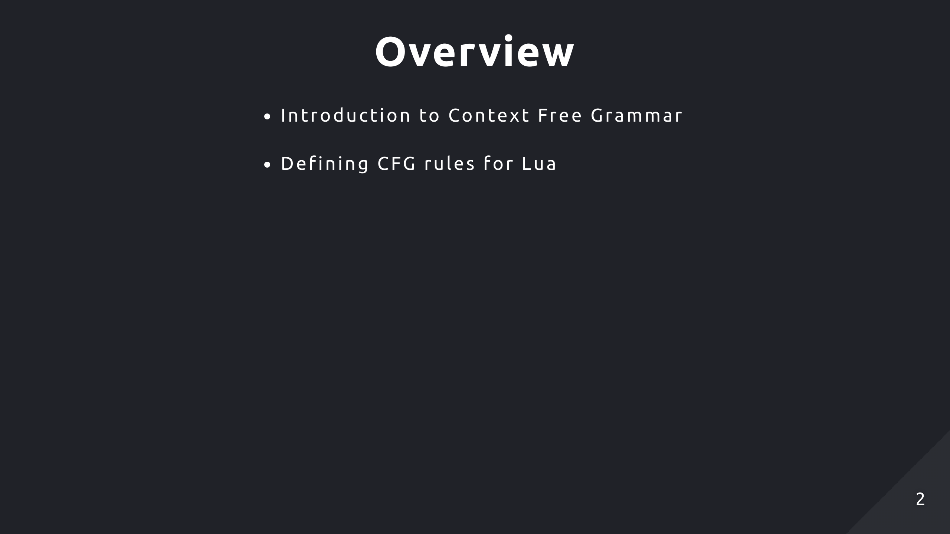

Slide 3
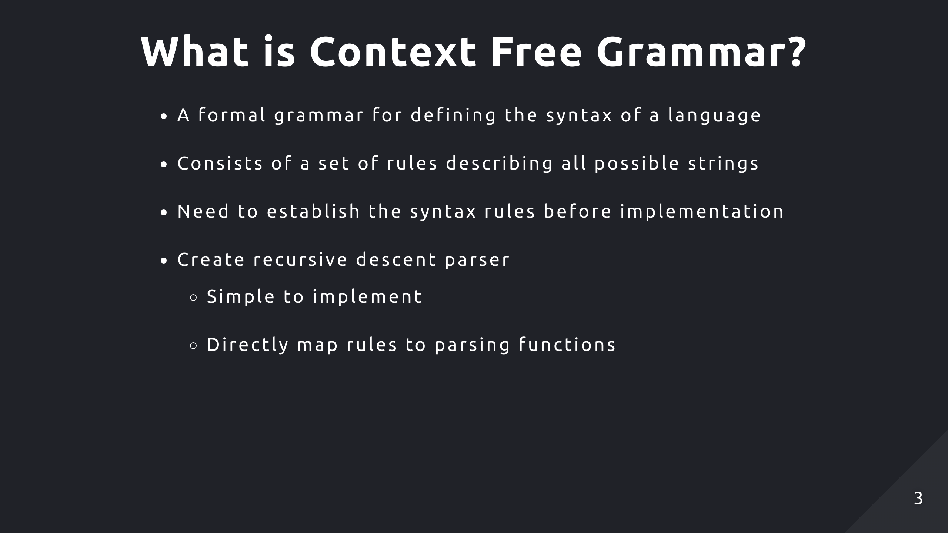
Notes:
It’s a top down parser because it parses from the top most grammar rule then makes its way into nested subexpressions
It’s pretty much a literal translation of grammar rules into code, where each rule is a function

Slide 4
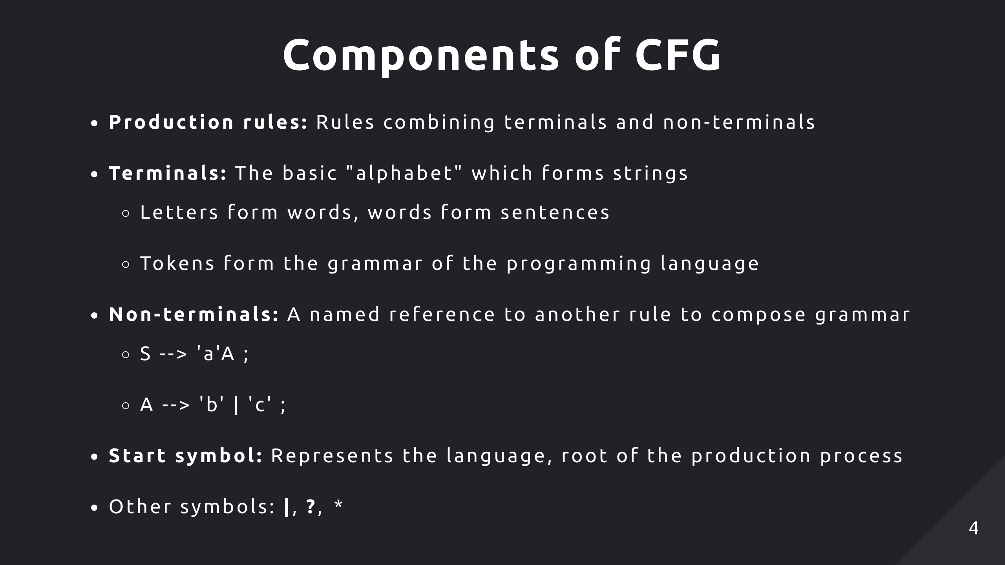

Slide 5
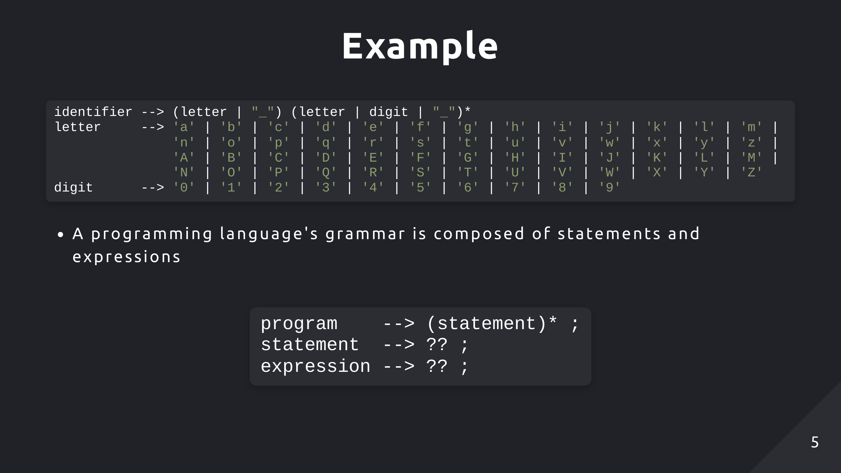
Notes:
Expressions can be used within statements to compute values and make decisions

Slide 6
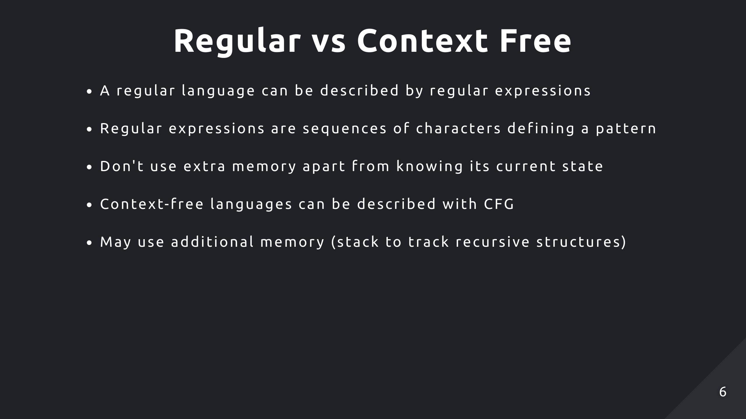
Notes:
Regular languages can be recognised by finite automata which is just a state machine
It can only be in one state at a time. There are finite number of states
Context free languages can be recognised by pushdown automata

Slide 7
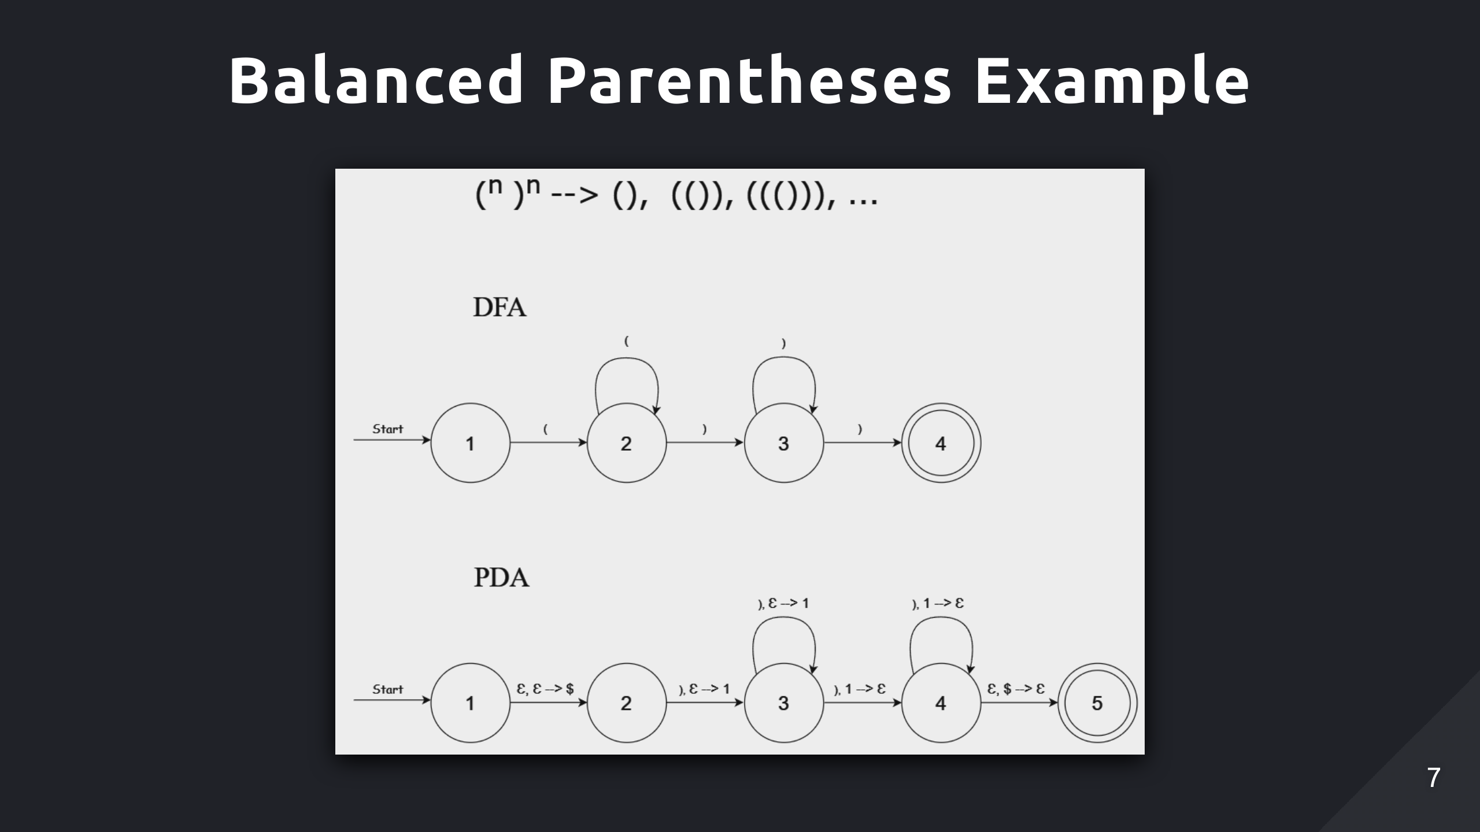
NFA
PDA
Notes:
State diagrams for two computational models
Non-deterministic finite automata recognises regular languages
Pushdown automata recognises context free languages, includes a stack

Slide 8
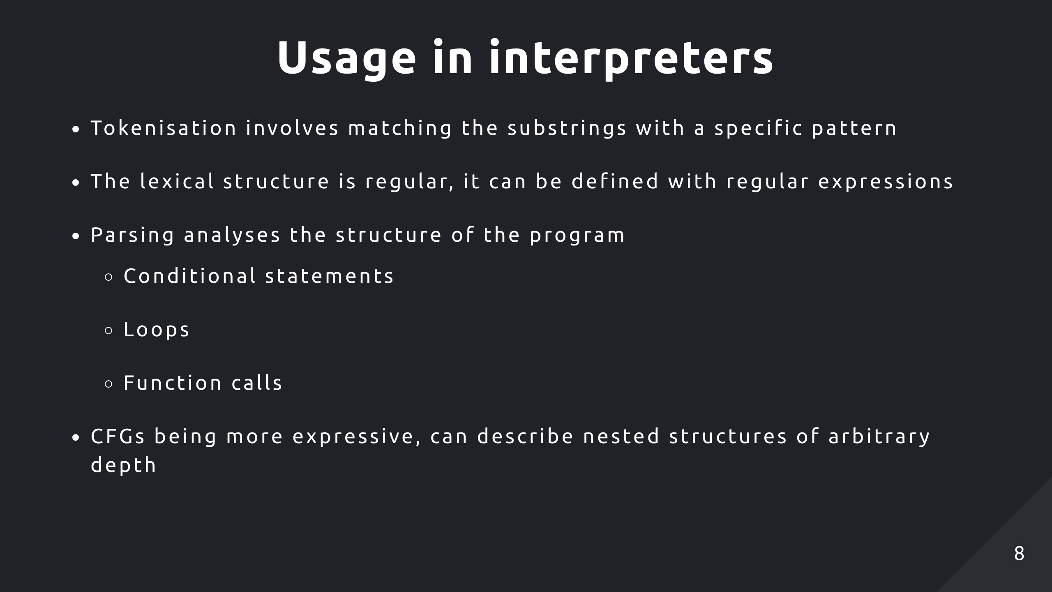

Slide 9
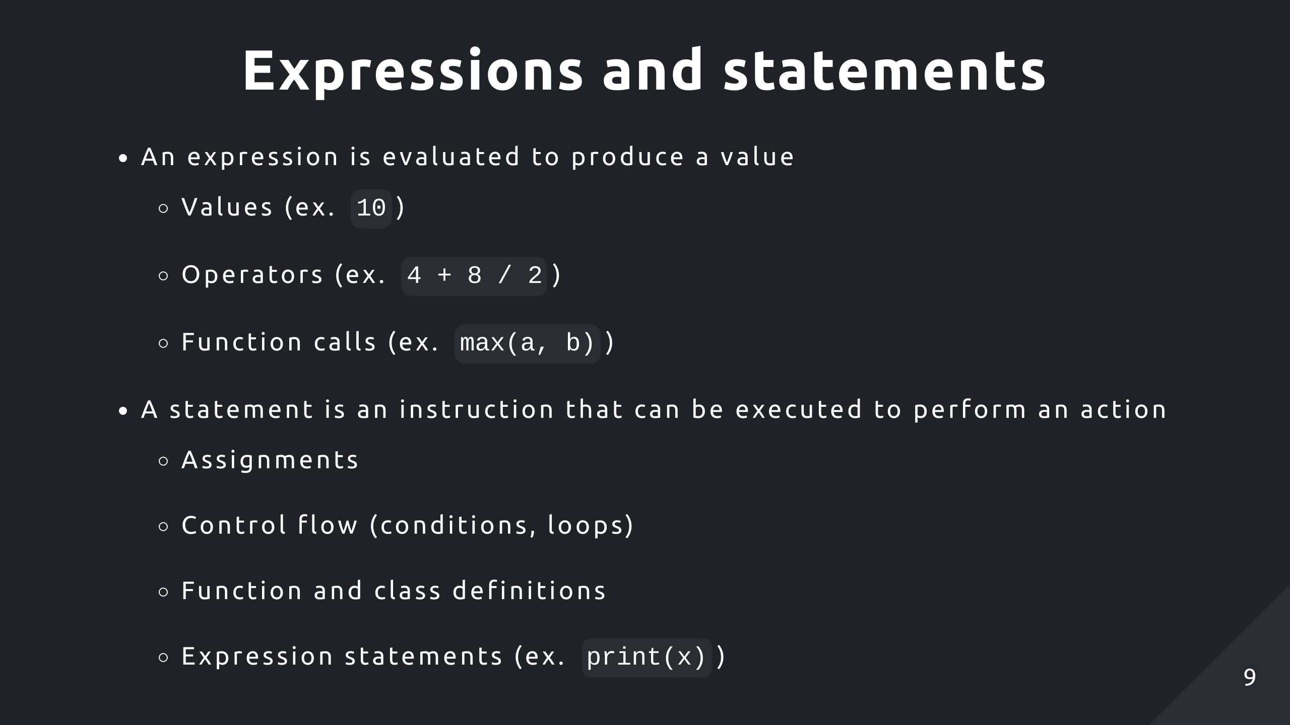

Slide 10
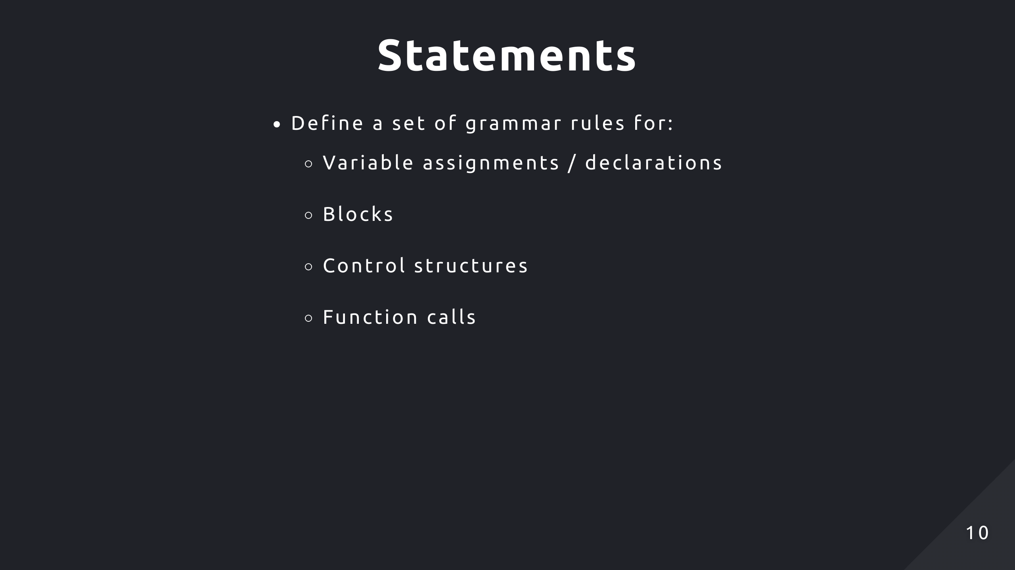

Slide 11
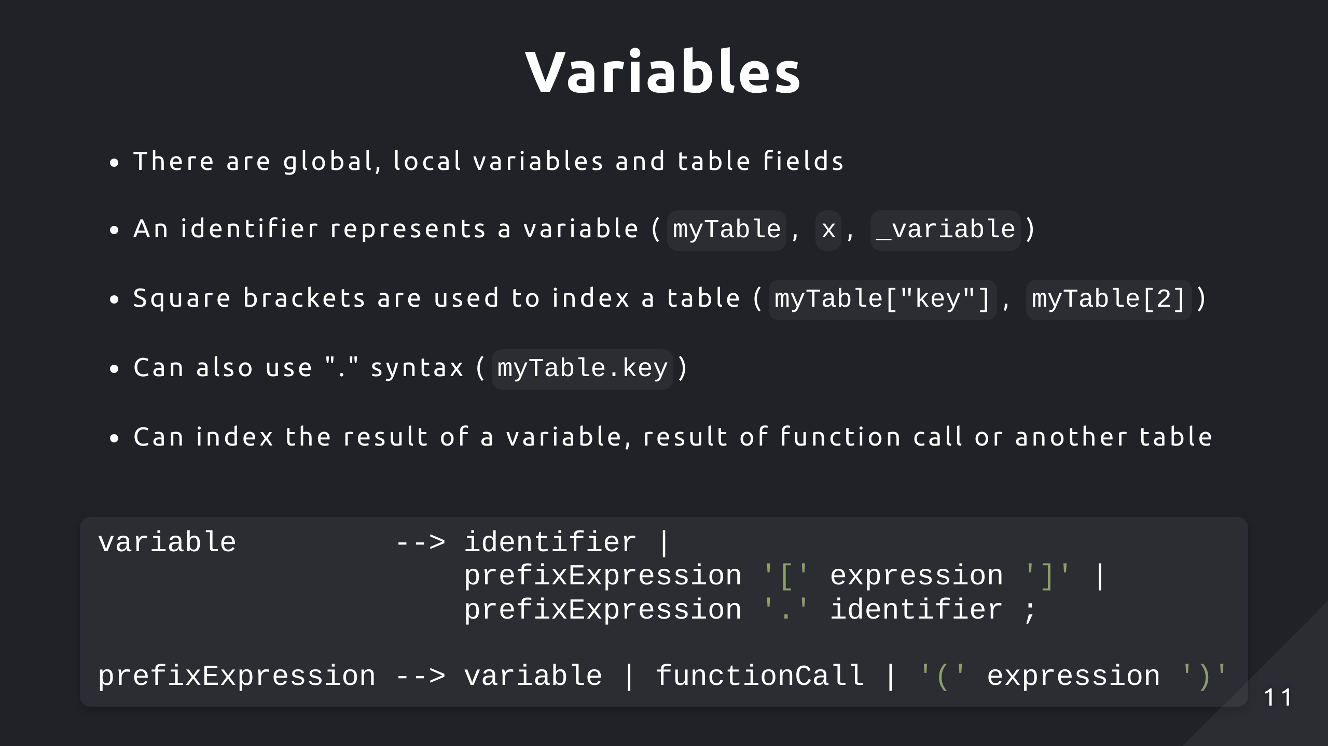
Notes:
PrefixExpression is used to denote a variety of expressions that could appear beforehand

Slide 12
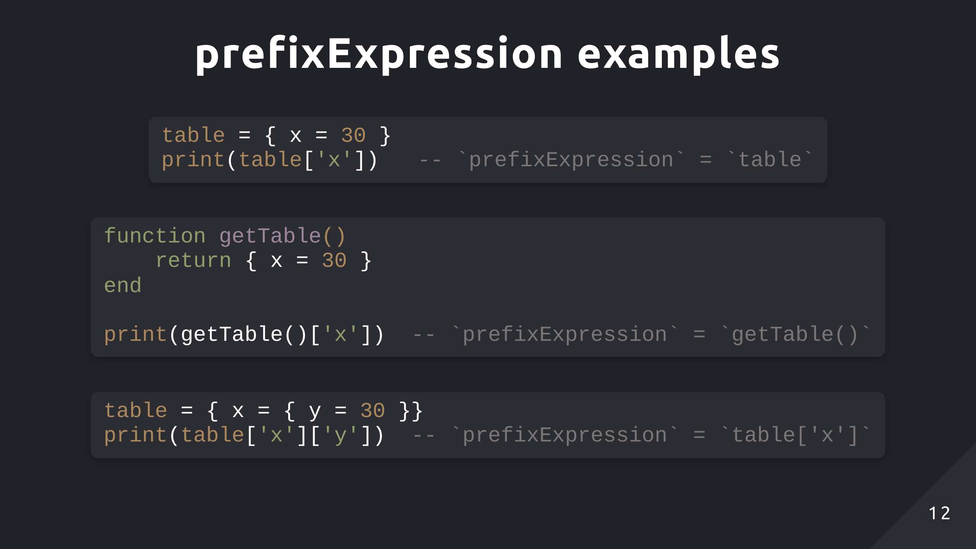

Slide 13
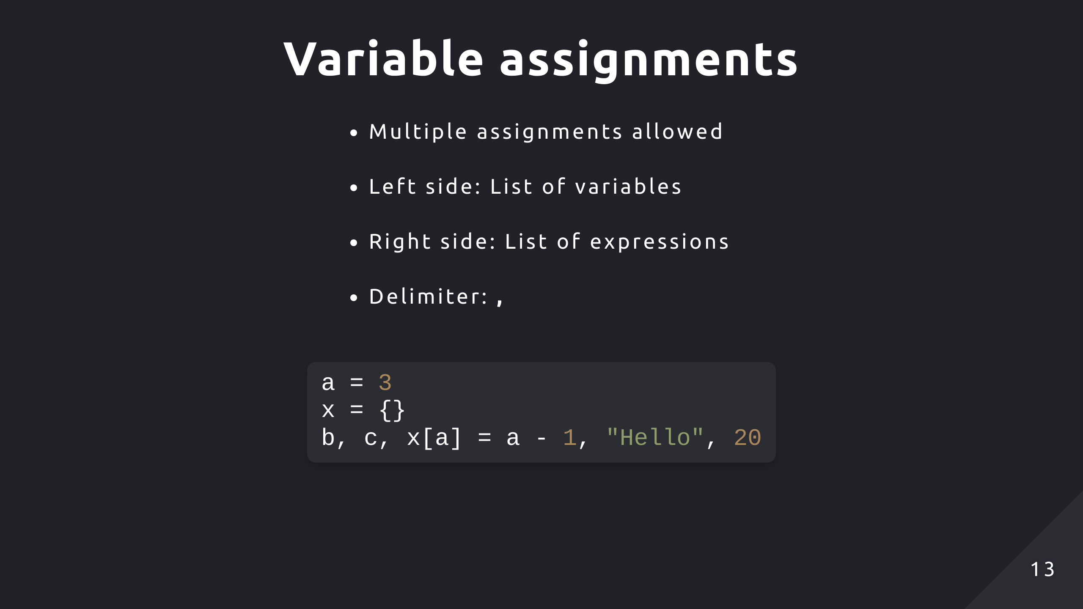
Notes:
Number of expressions doesn’t need to match number of variables
In Lua, uninitialised variables are set to nil

Slide 14
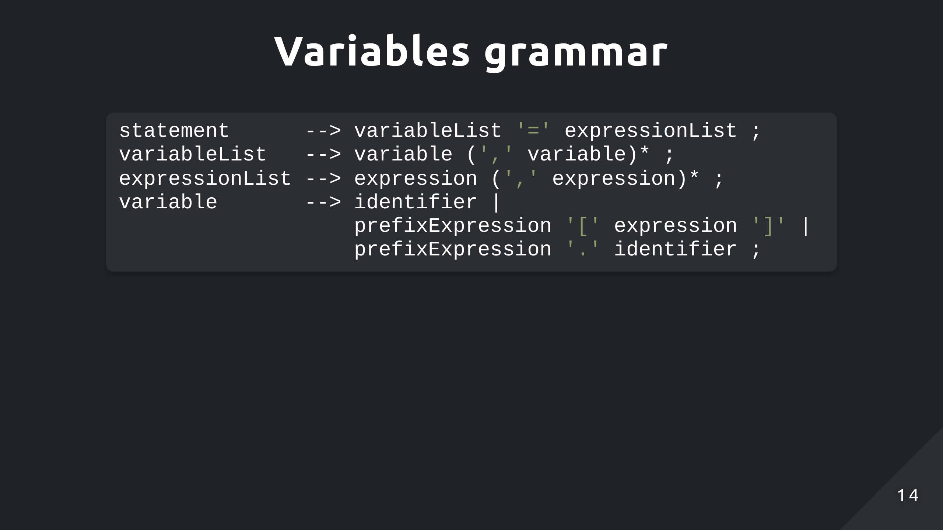

Slide 15
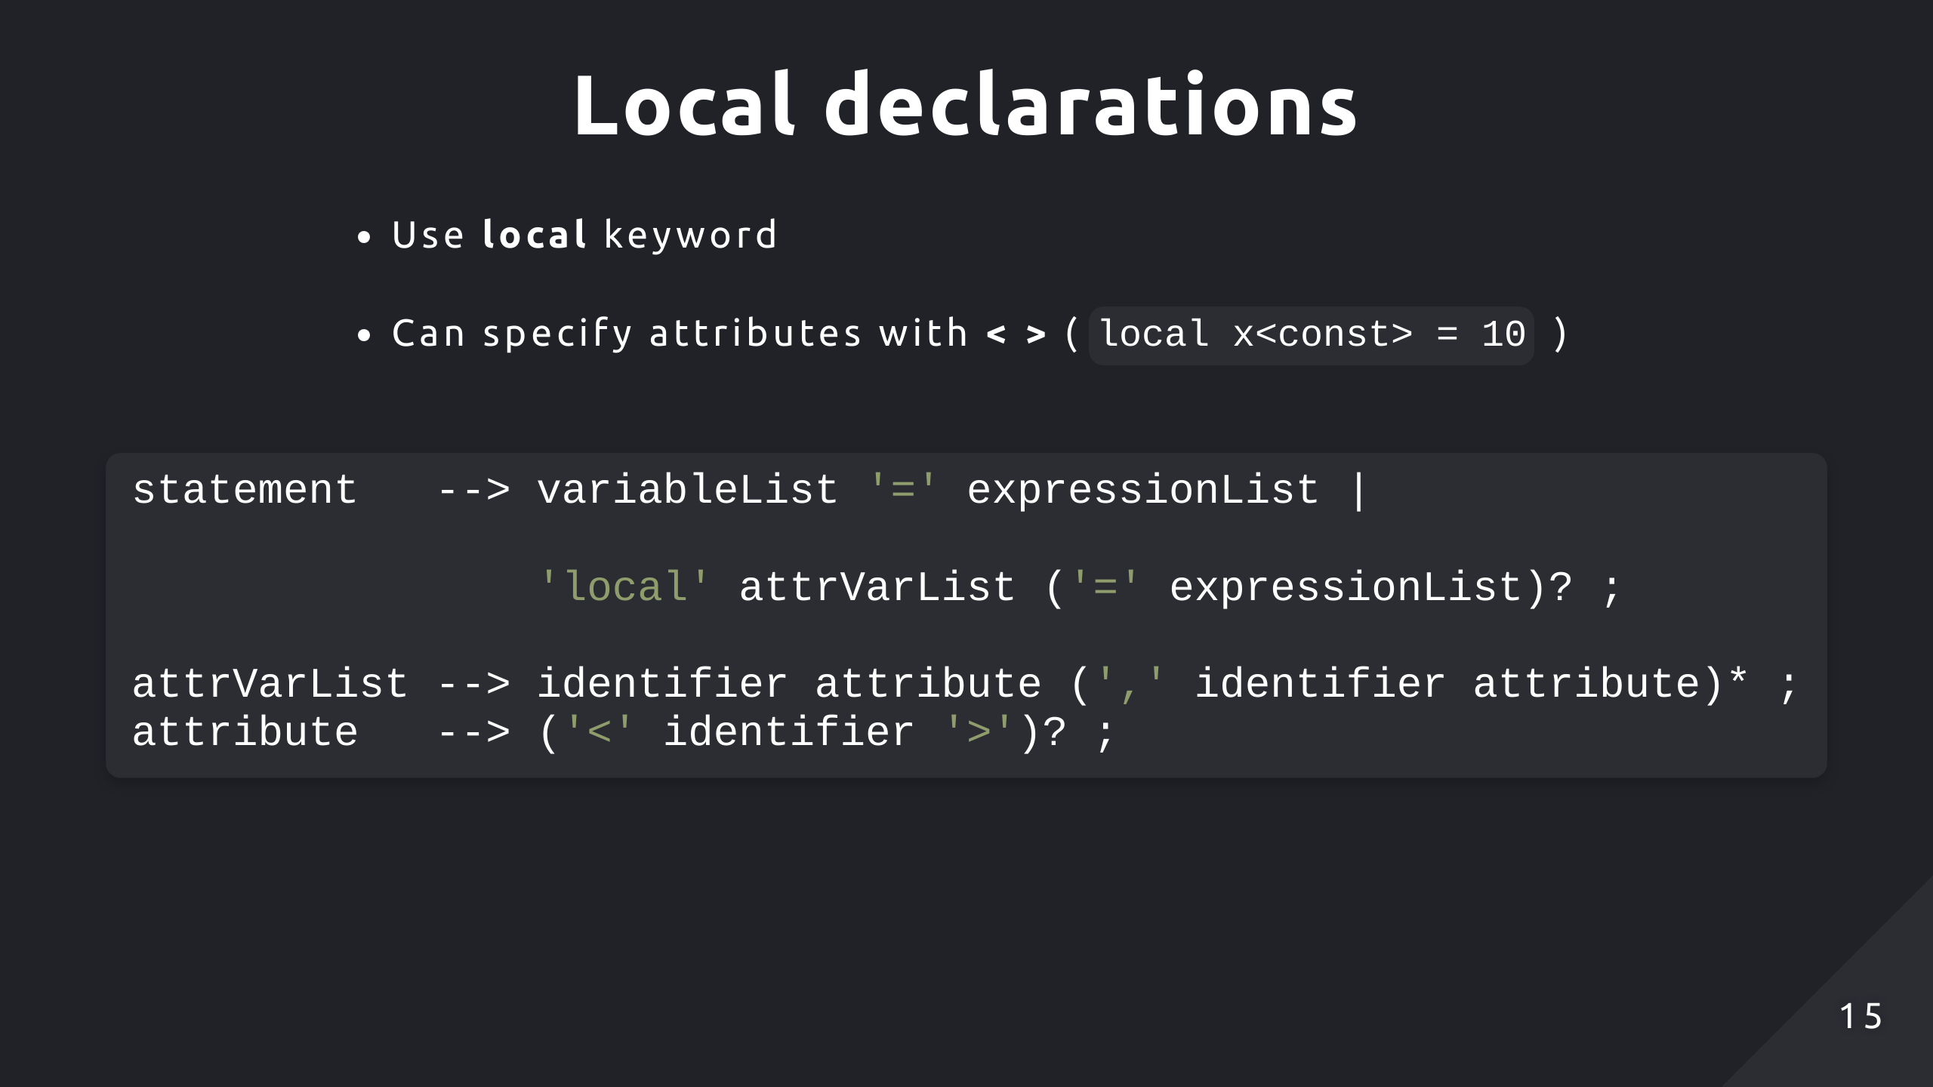
Notes:
Attributes aren’t available to global variables

Slide 16
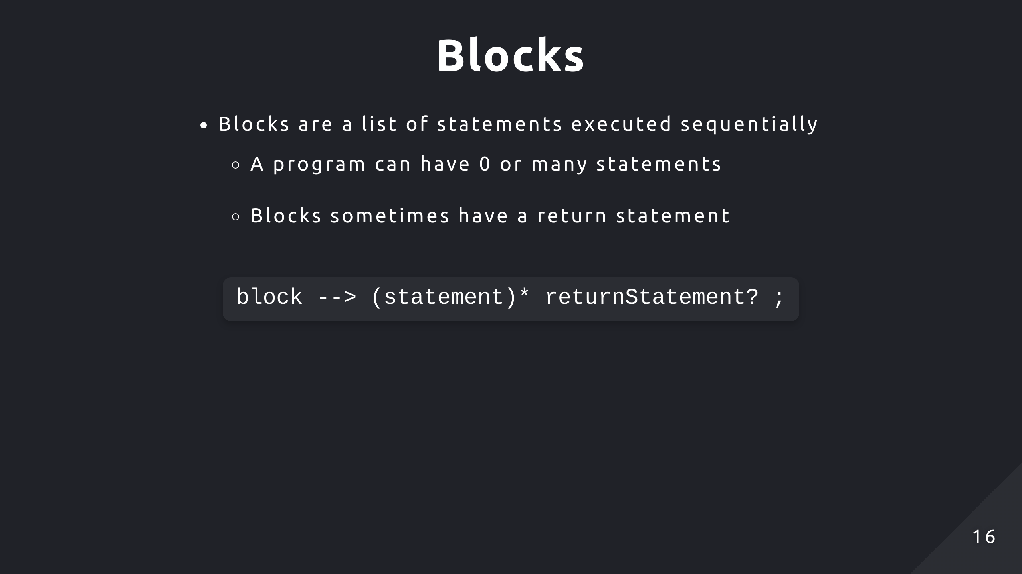

Slide 17
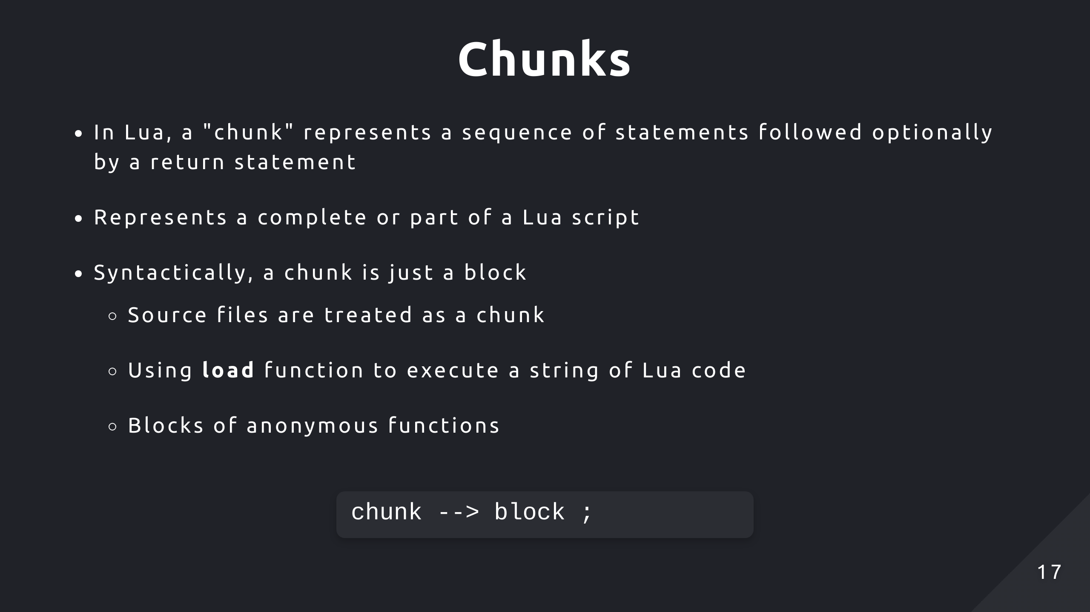
Notes:
Chunk is essentially the starting symbol, or most top level rule

Slide 18
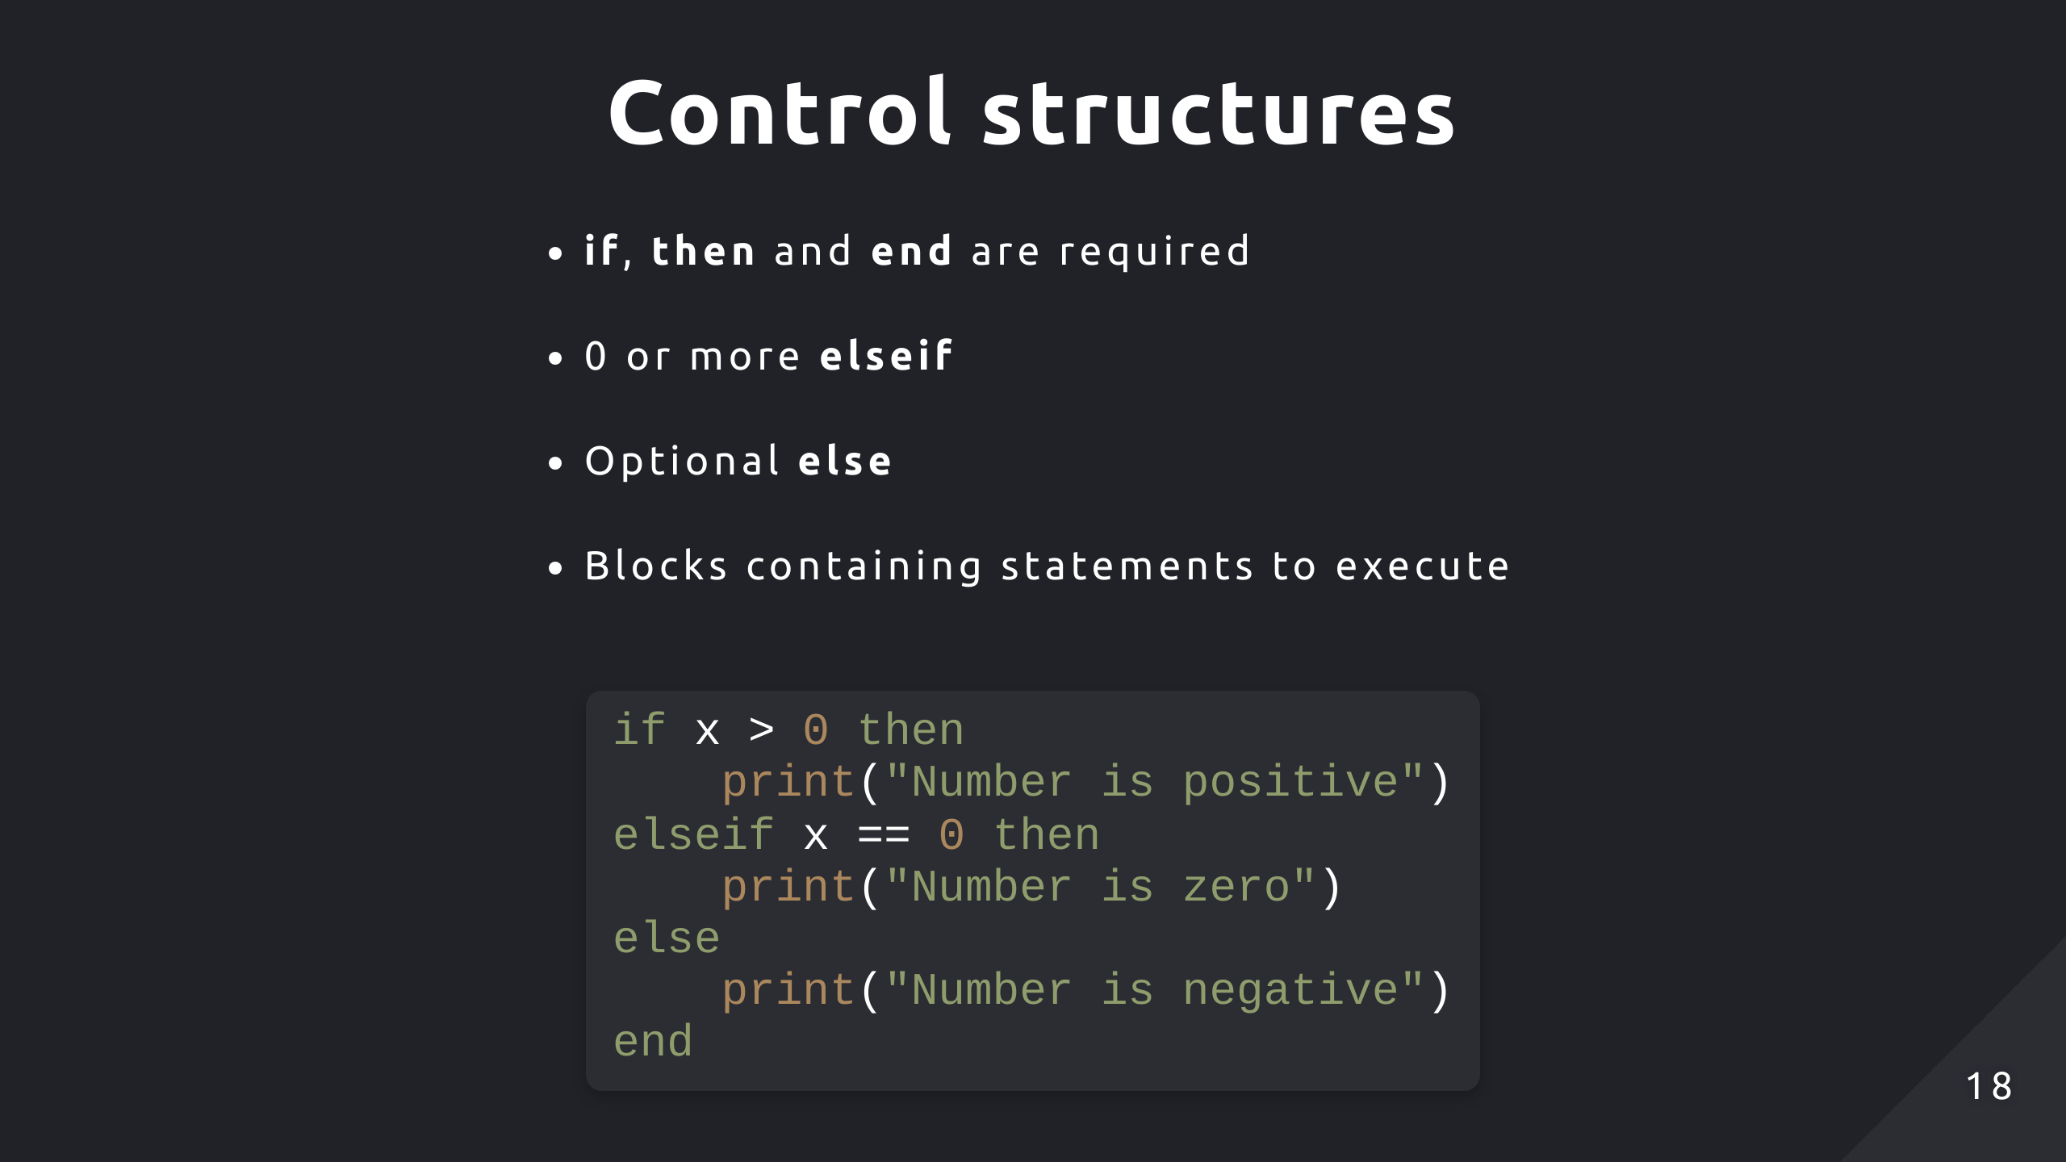

Slide 19
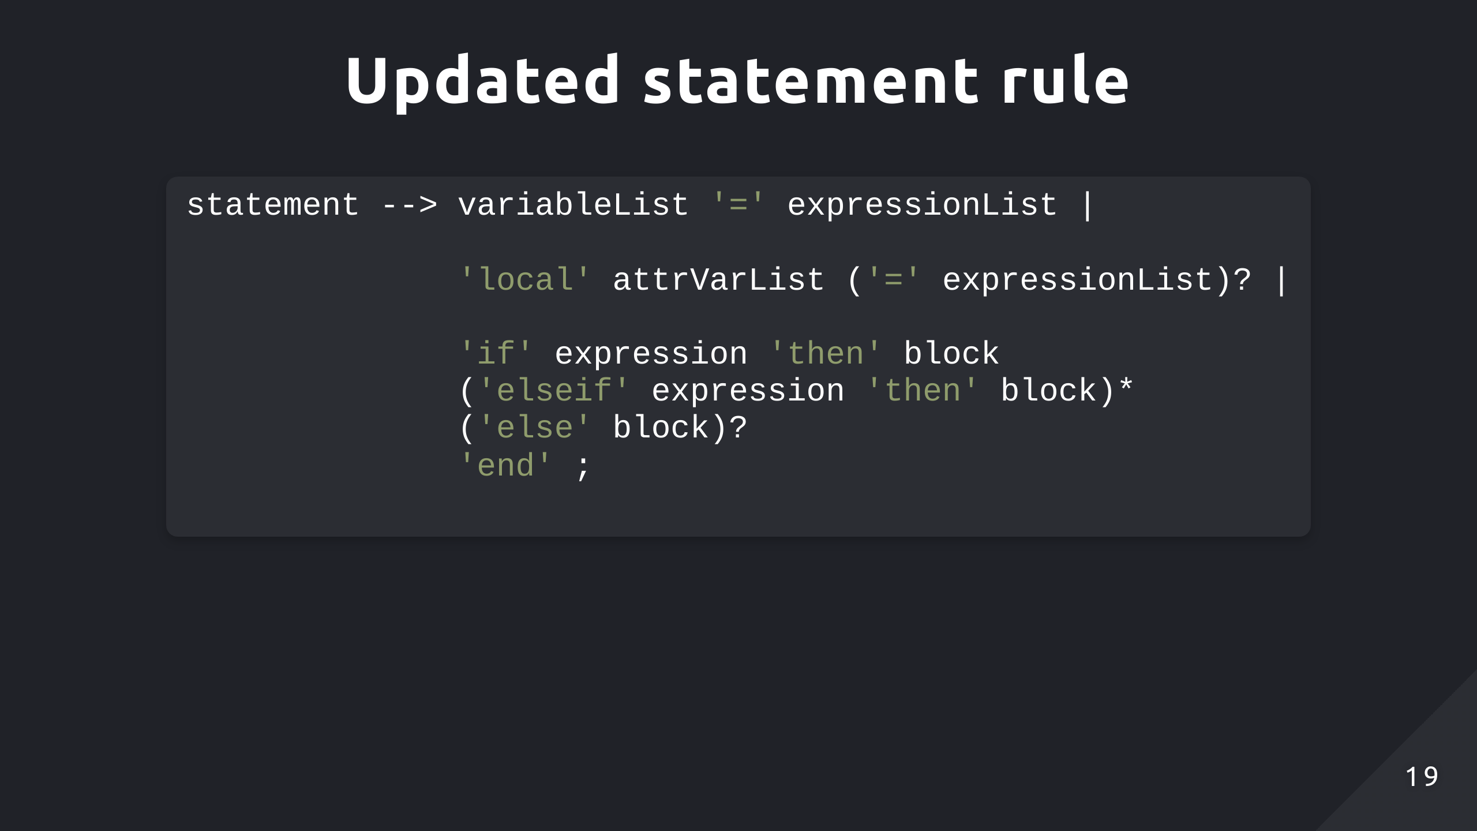

Slide 20
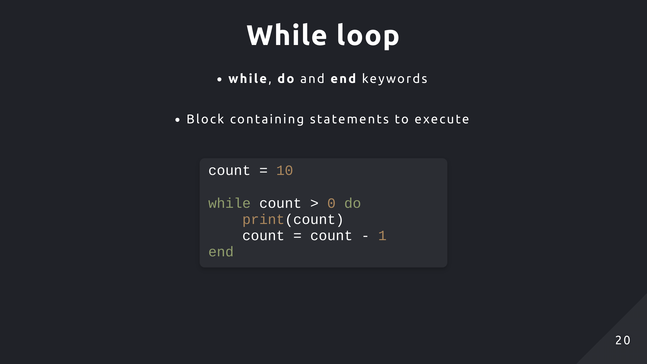

Slide 21
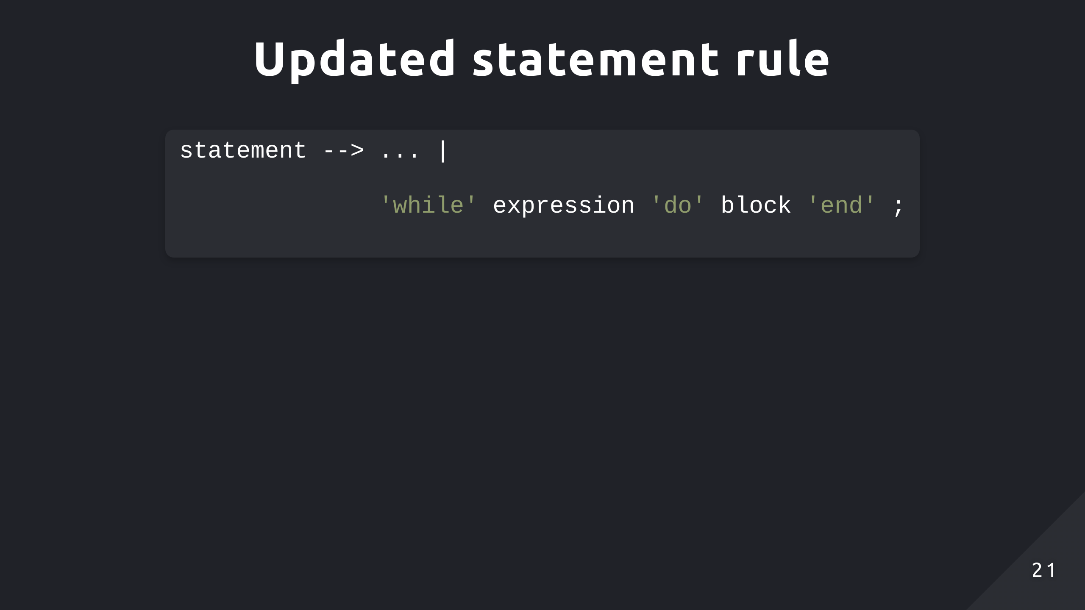

Slide 22
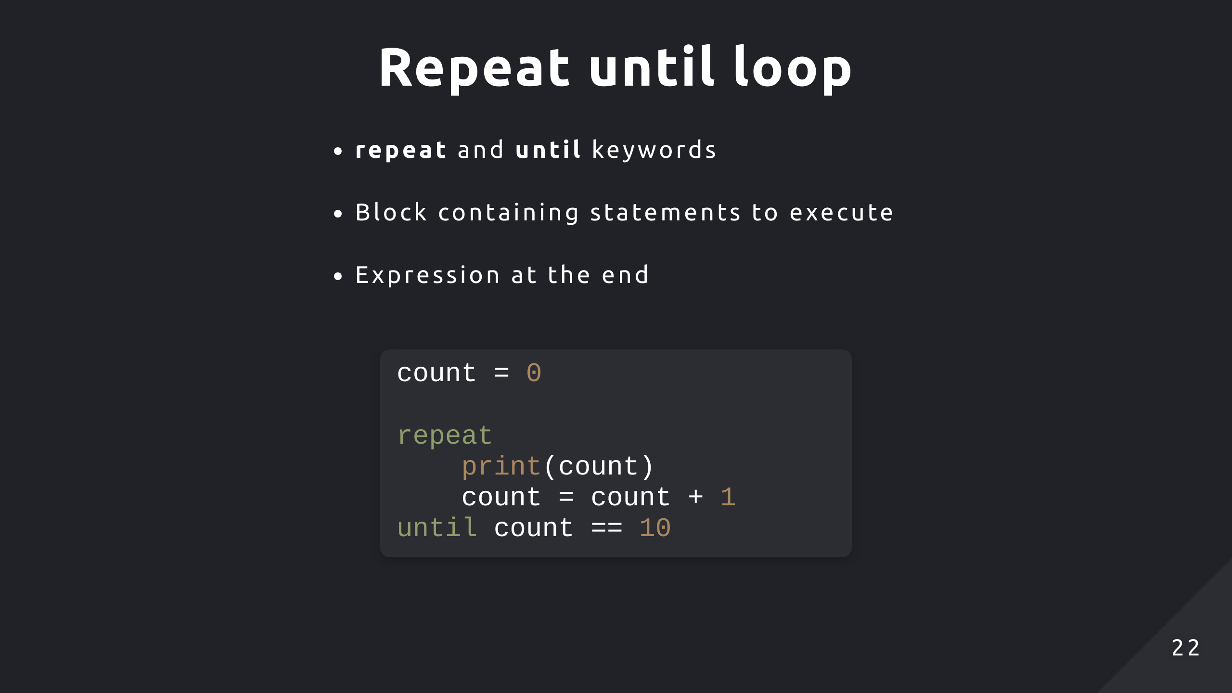

Slide 23
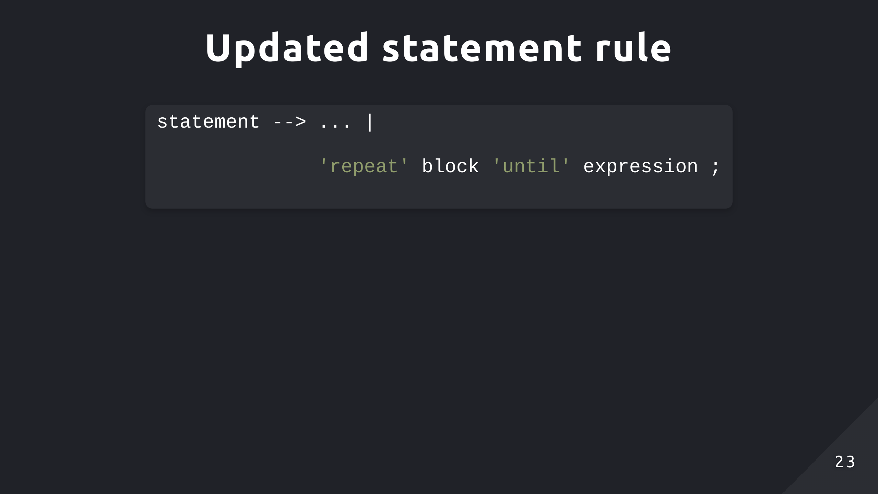

Slide 24
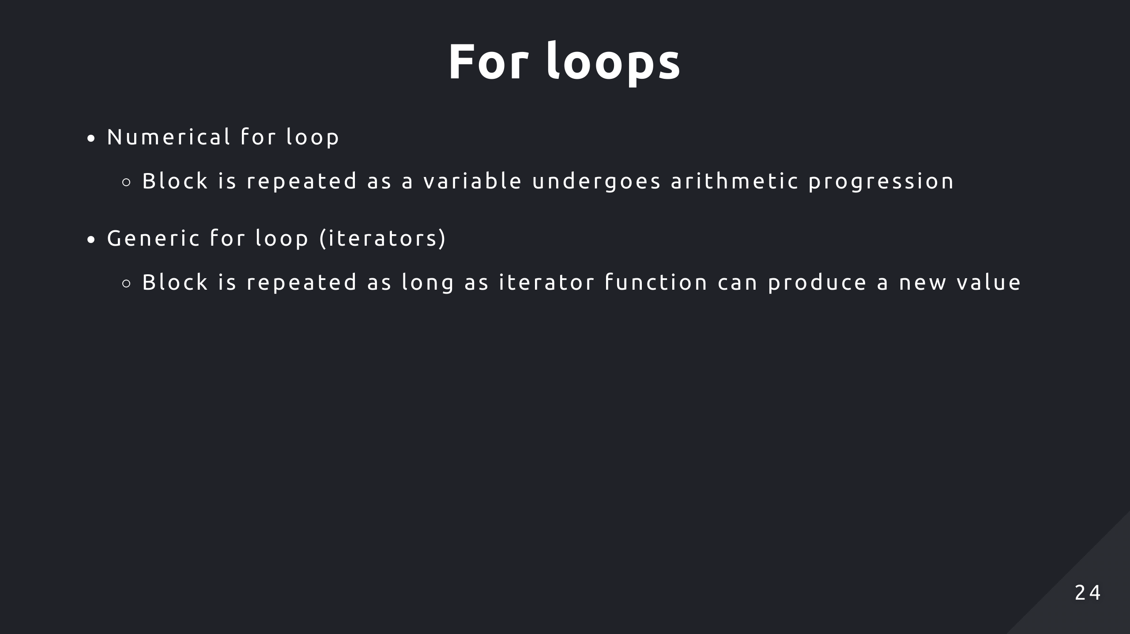

Slide 25
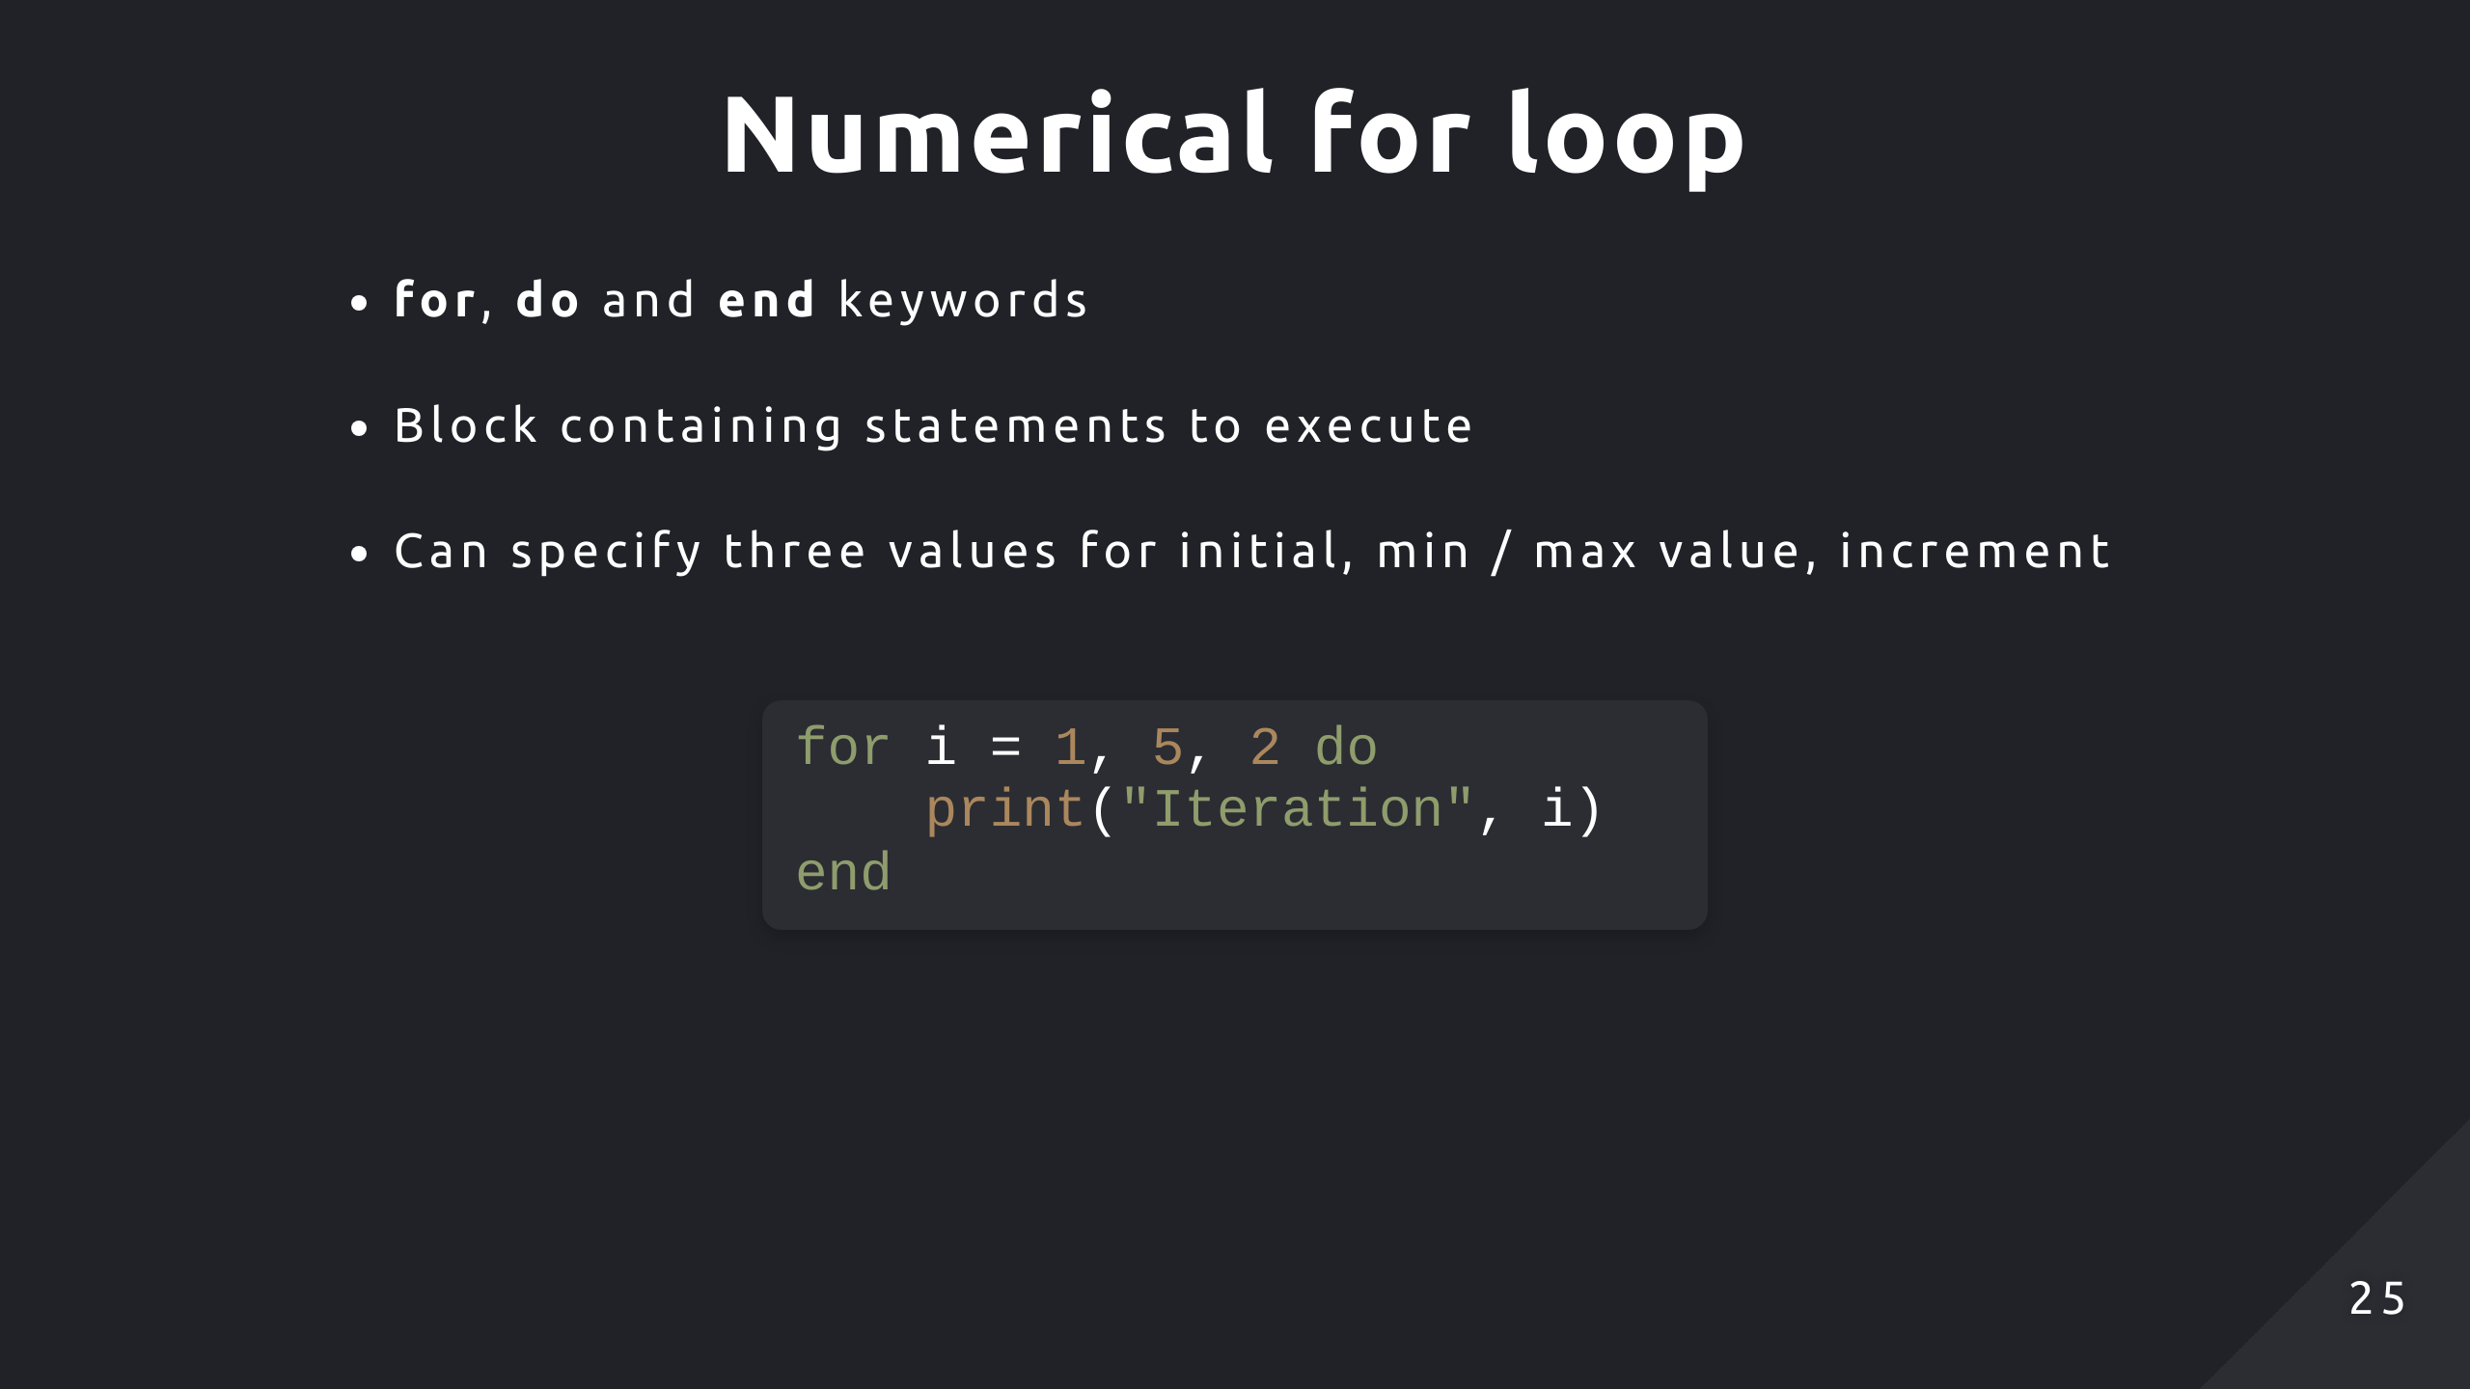
Notes:
3rd value is optional, default is +1

Slide 26
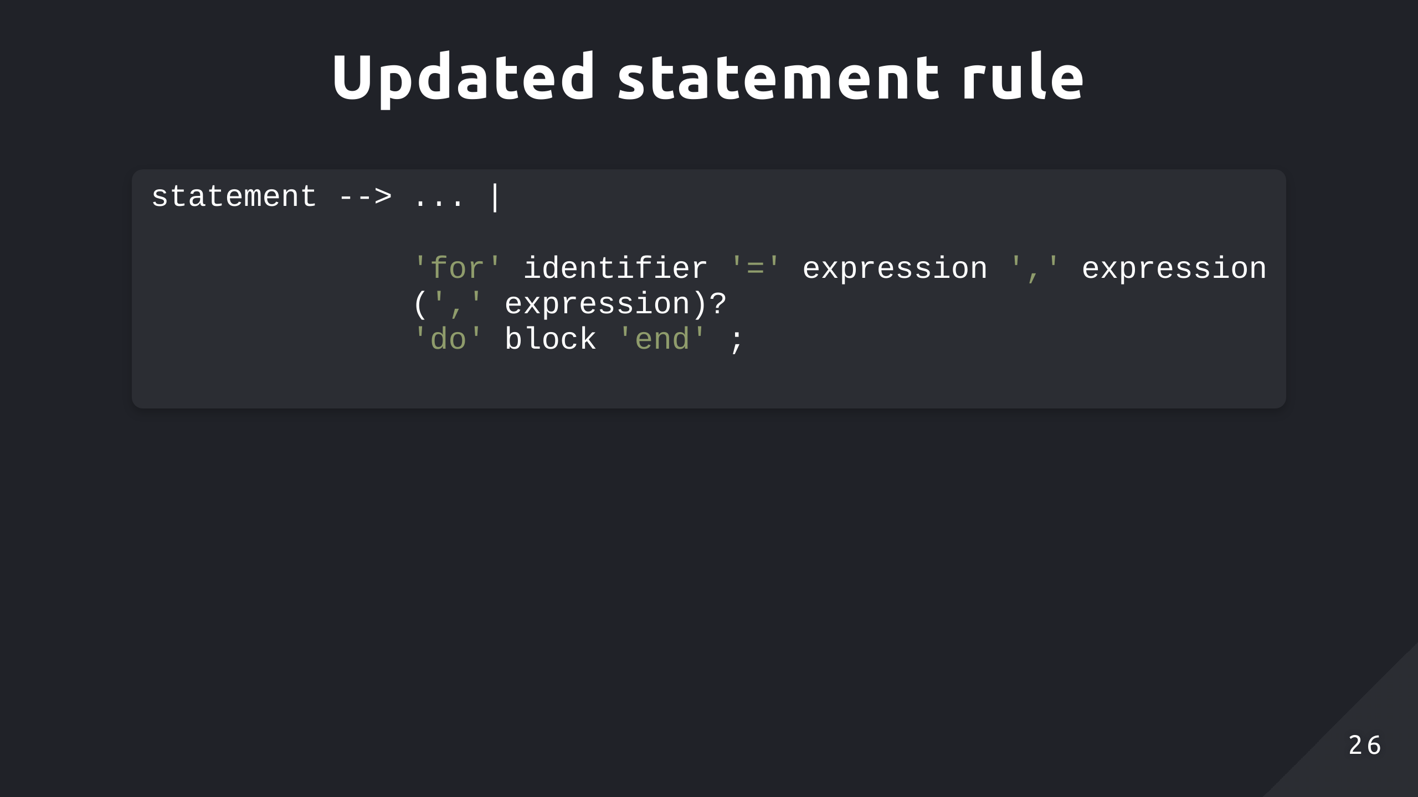

Slide 27
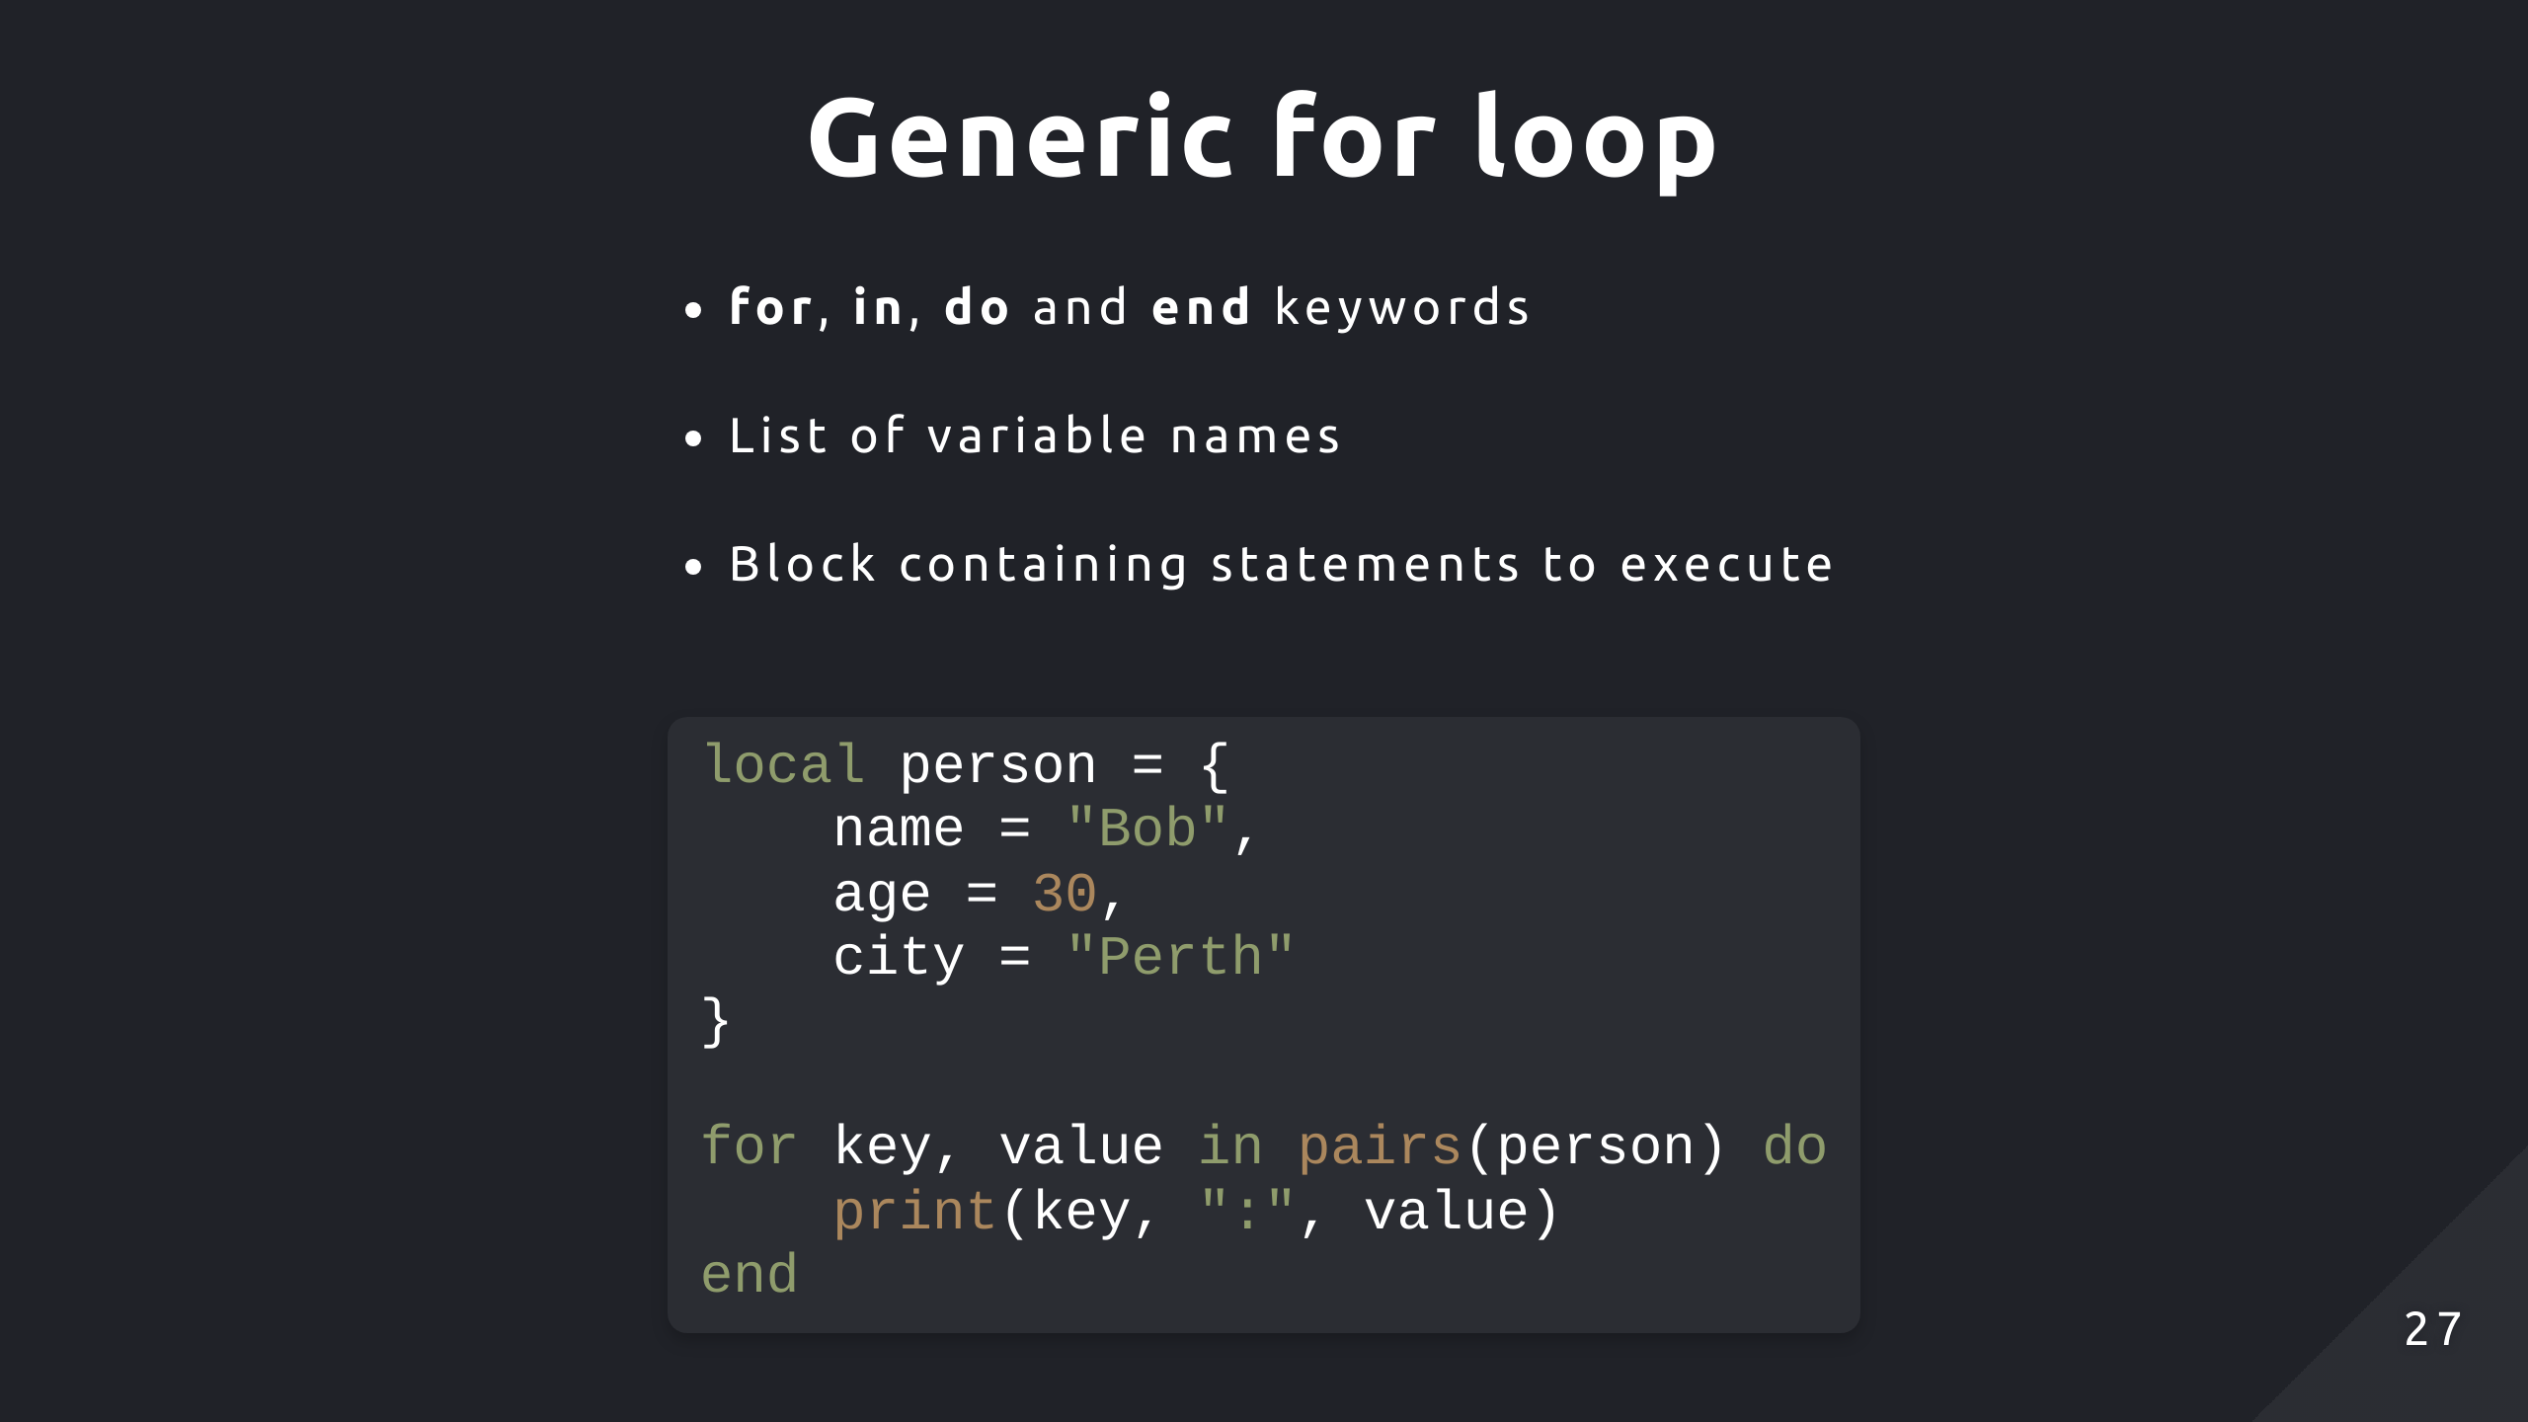
Notes:
Not limited to two variables, depends on the return type of pairs() which can be custom implemented

Slide 28
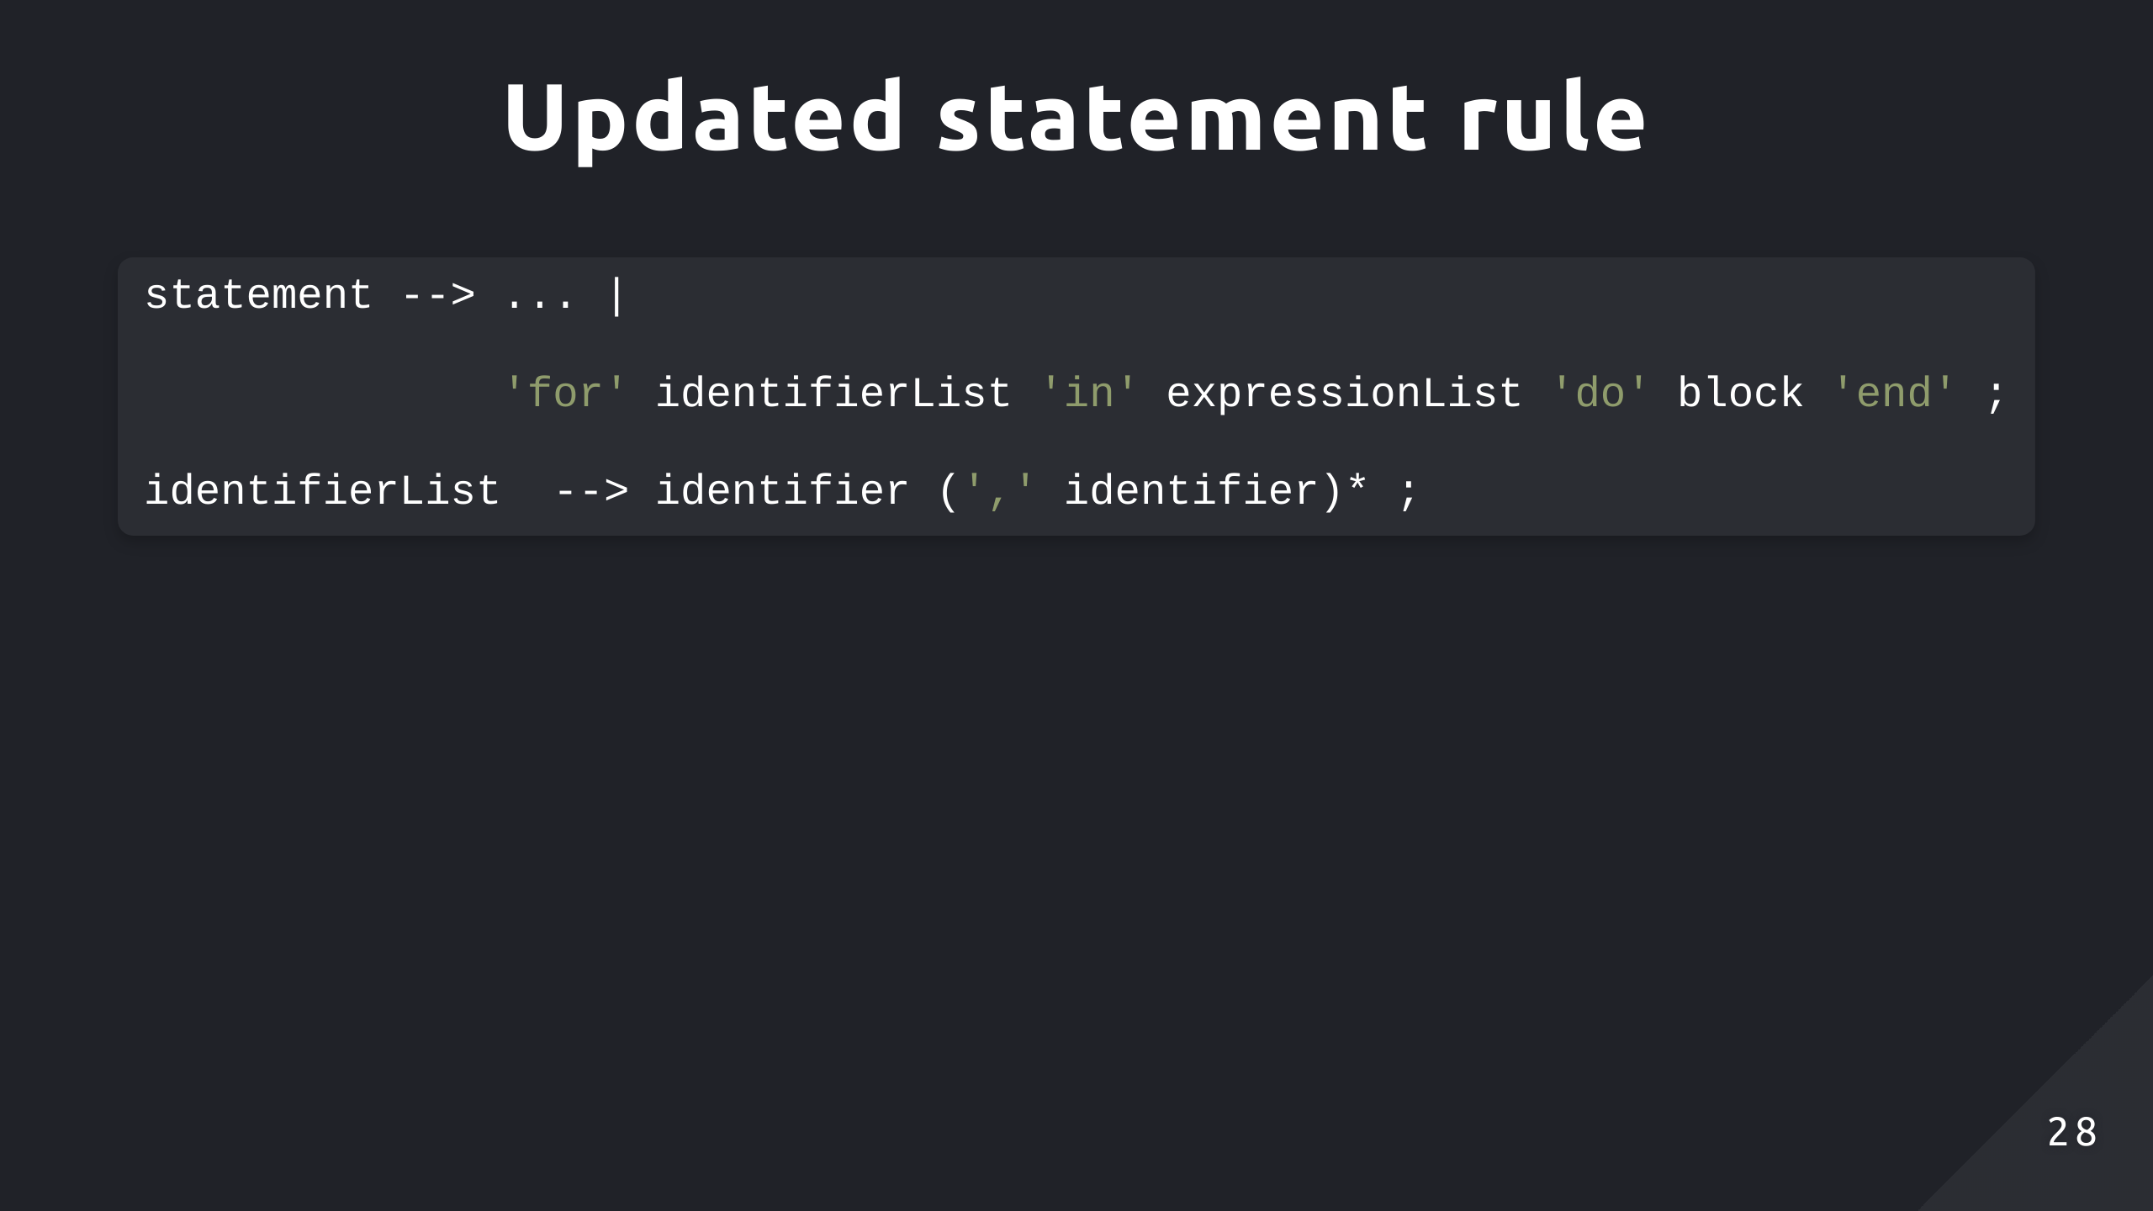

Slide 29
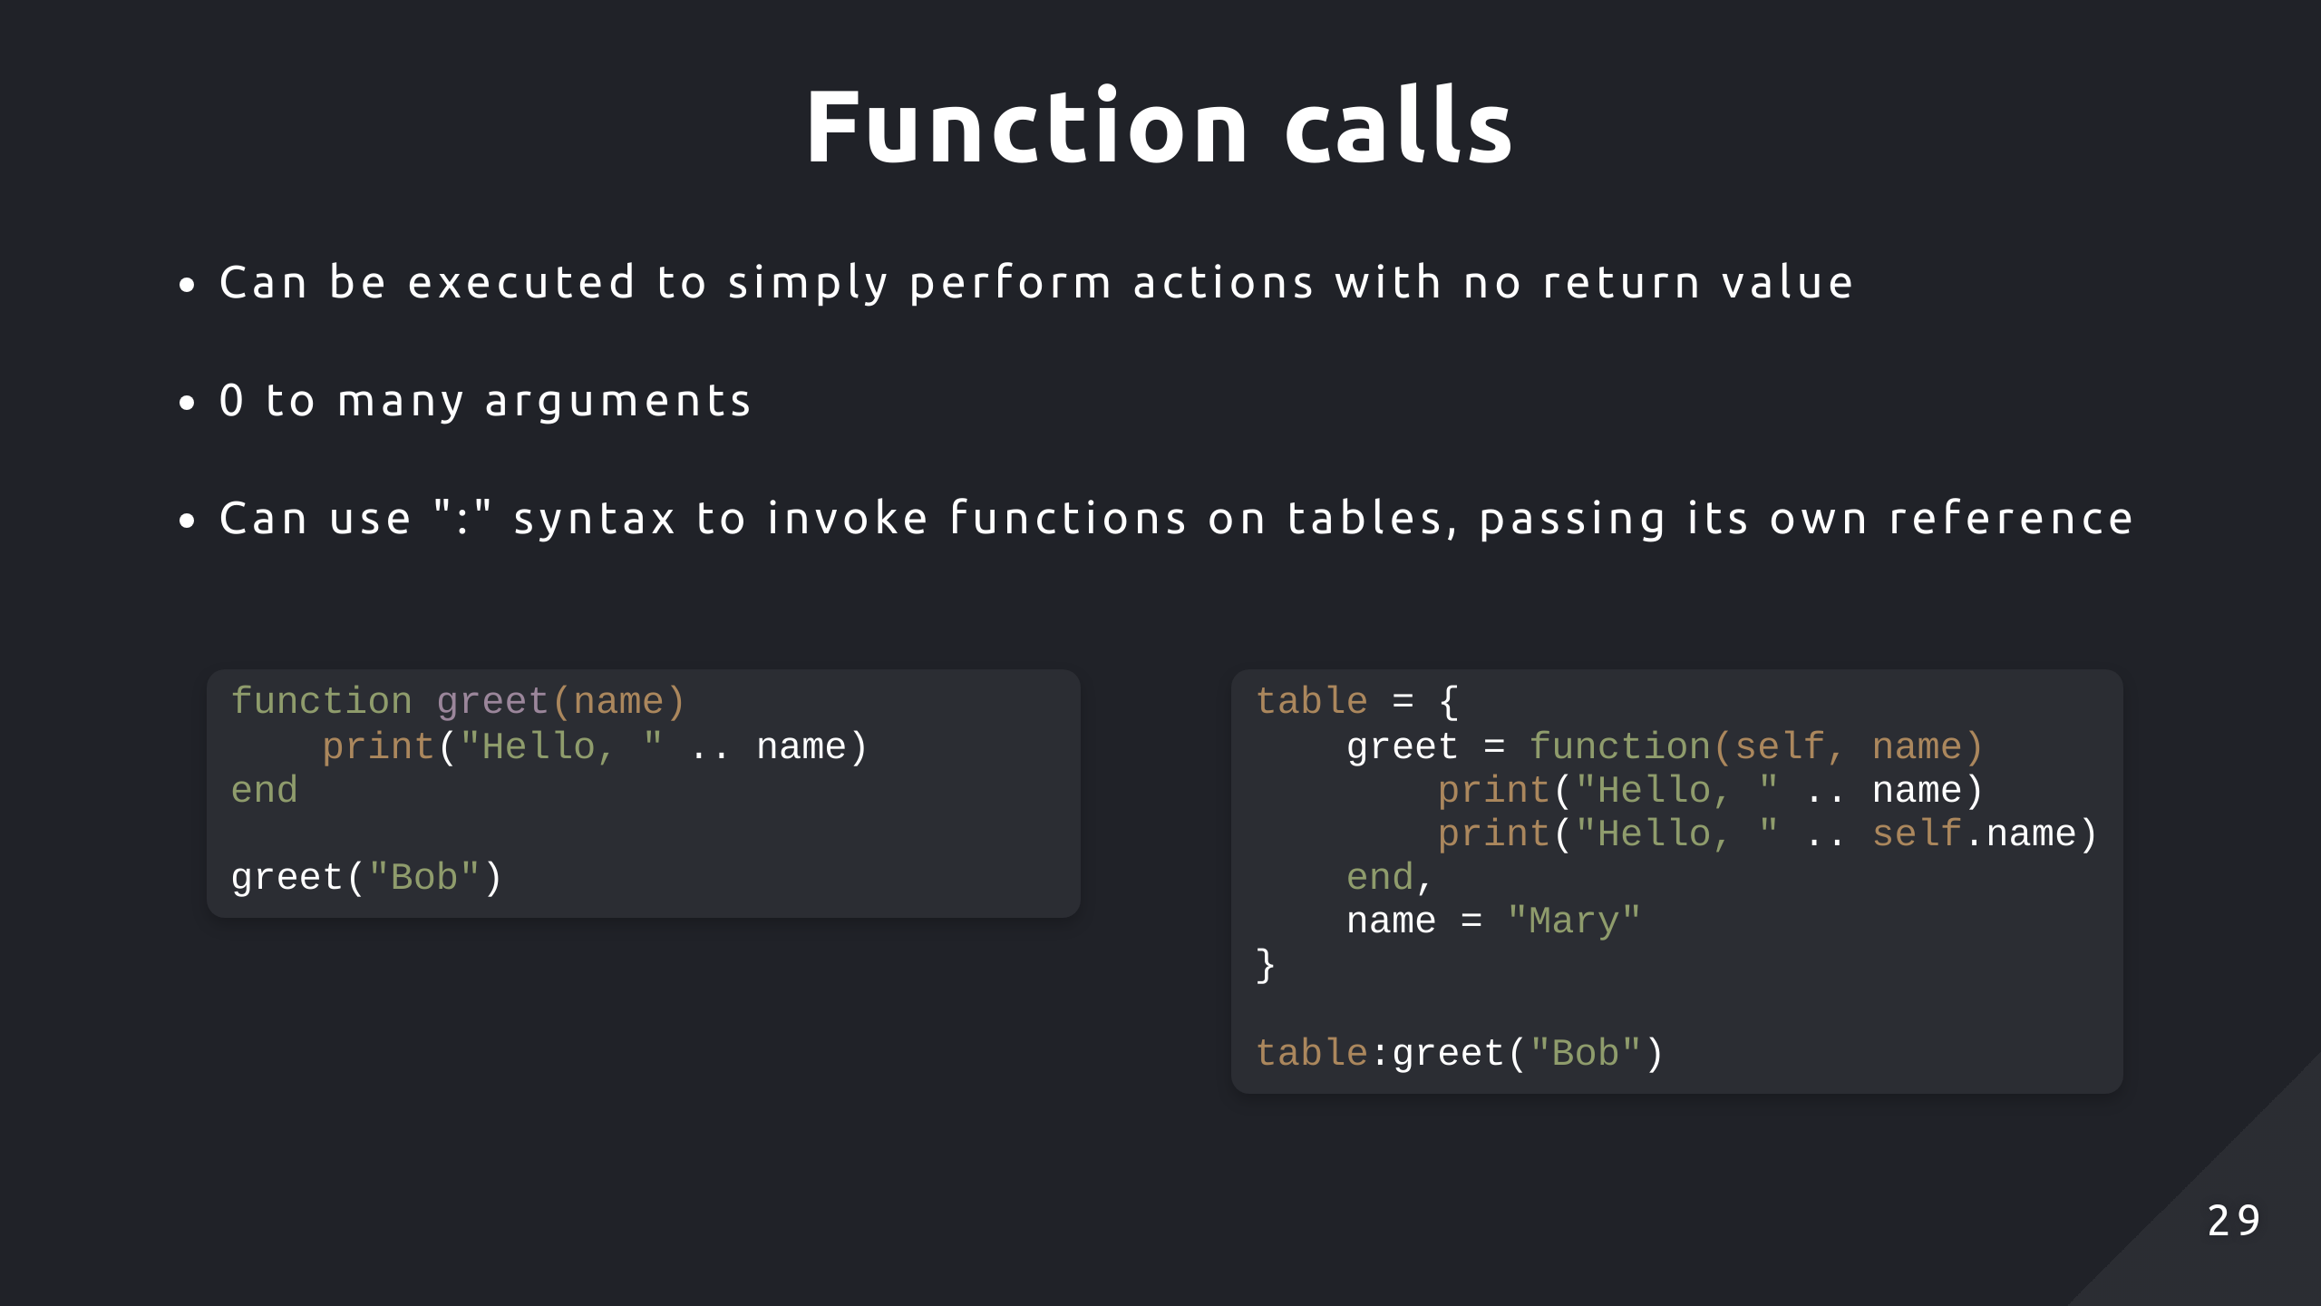

Slide 30
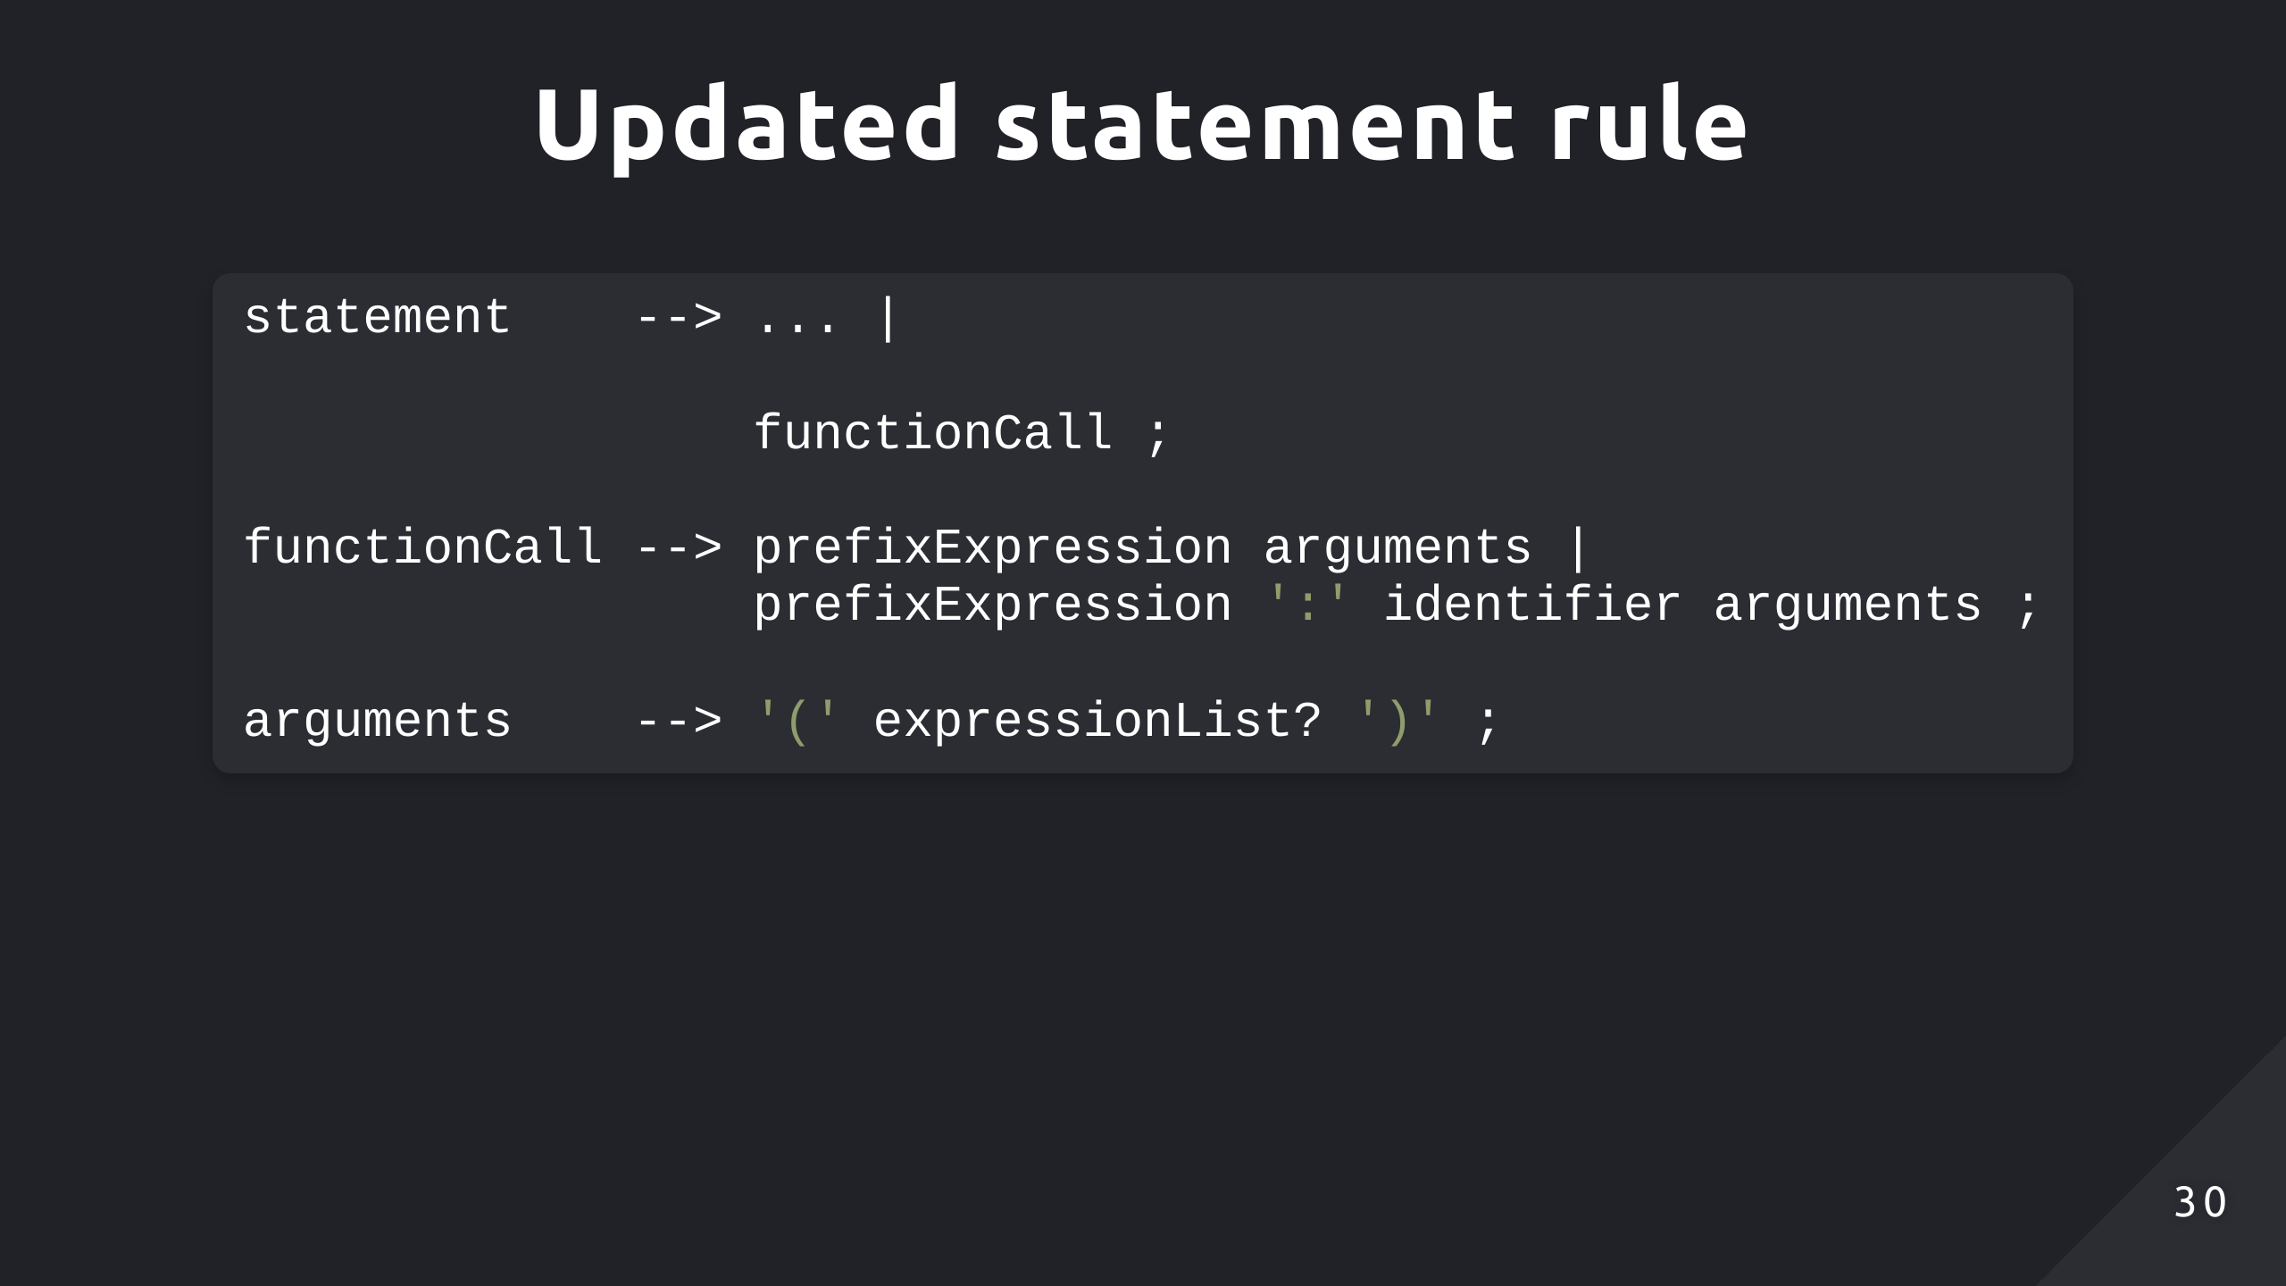

Slide 31
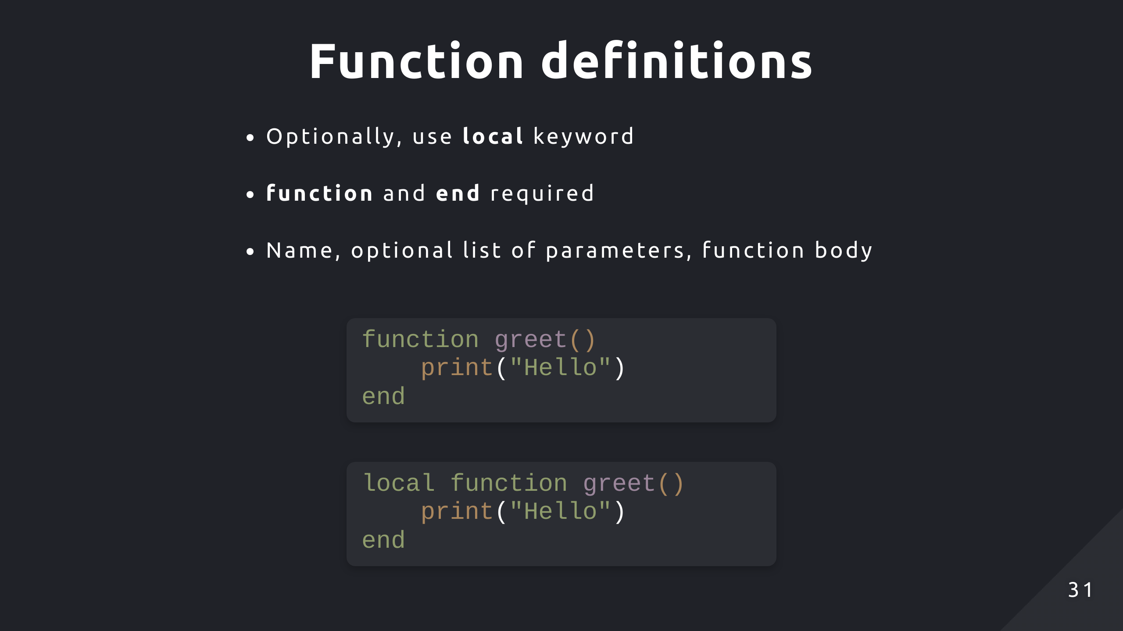

Slide 32
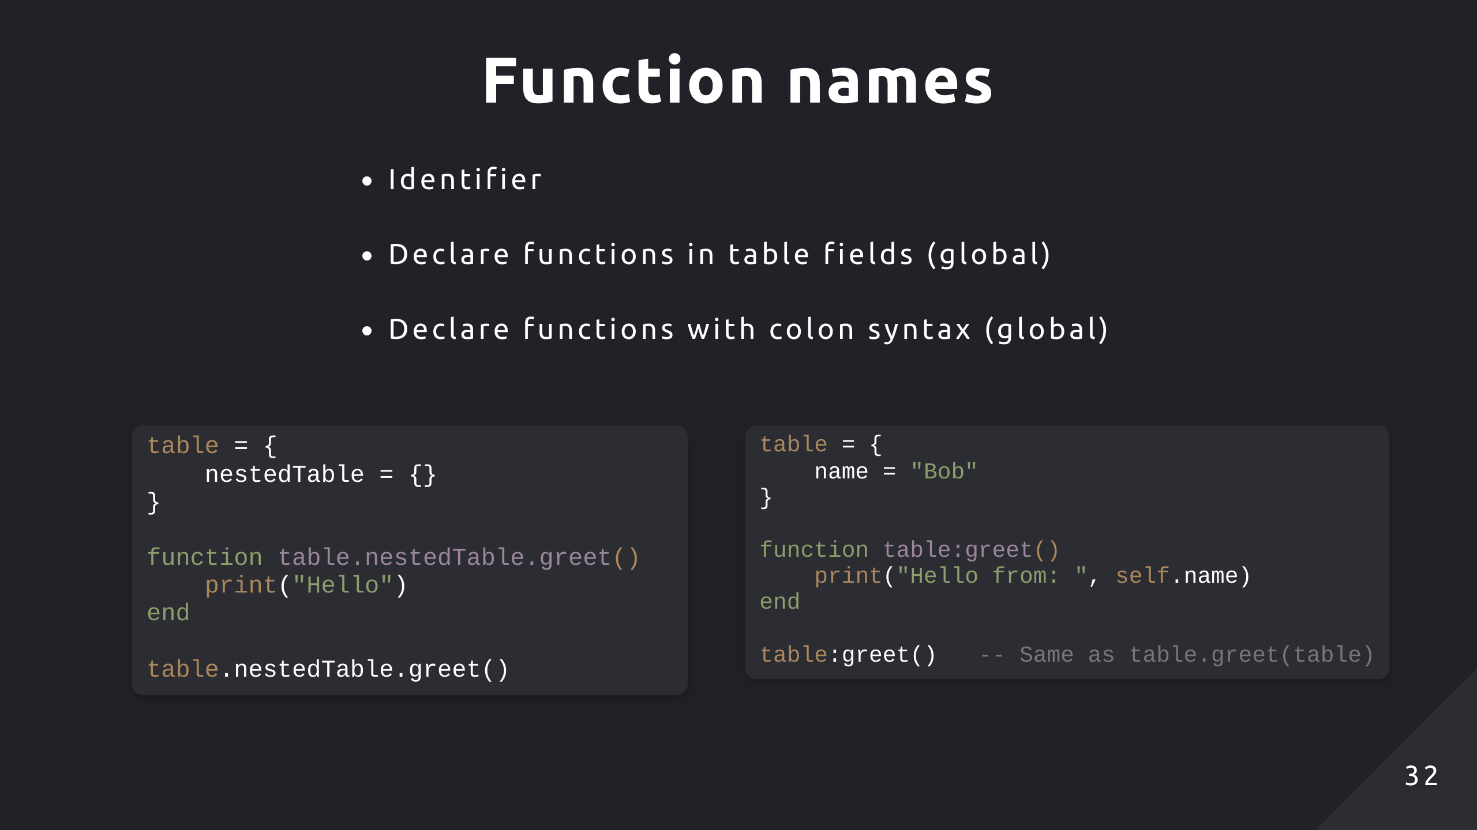
Notes:
Create a key on nestedTable which corresponds to a function
Create a key on table which corresponds to a function, it implicitly passes the table as a parameter

Slide 33
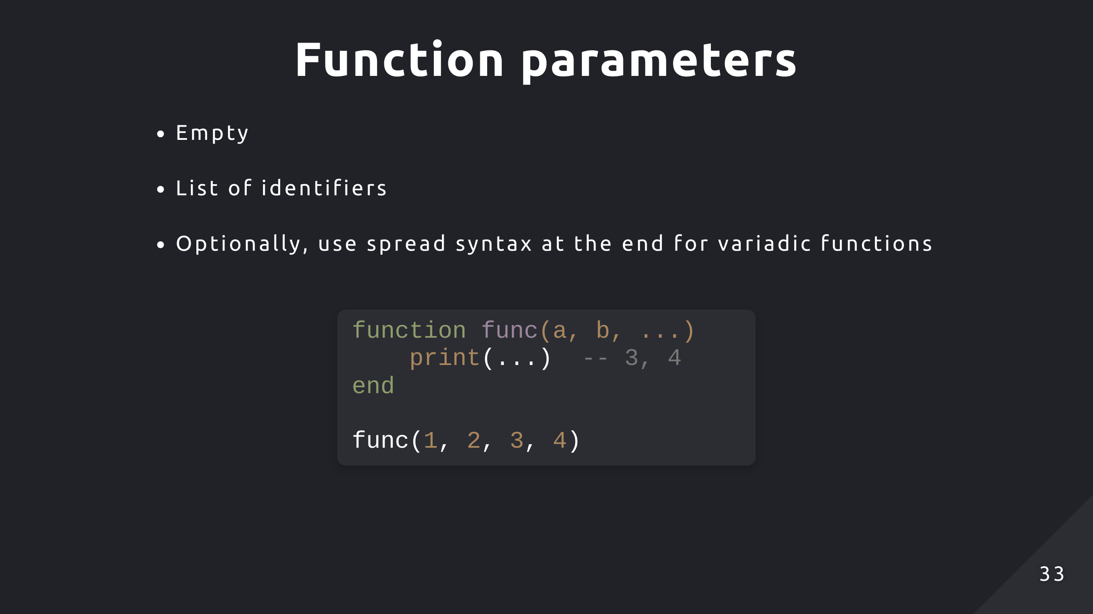

Slide 34
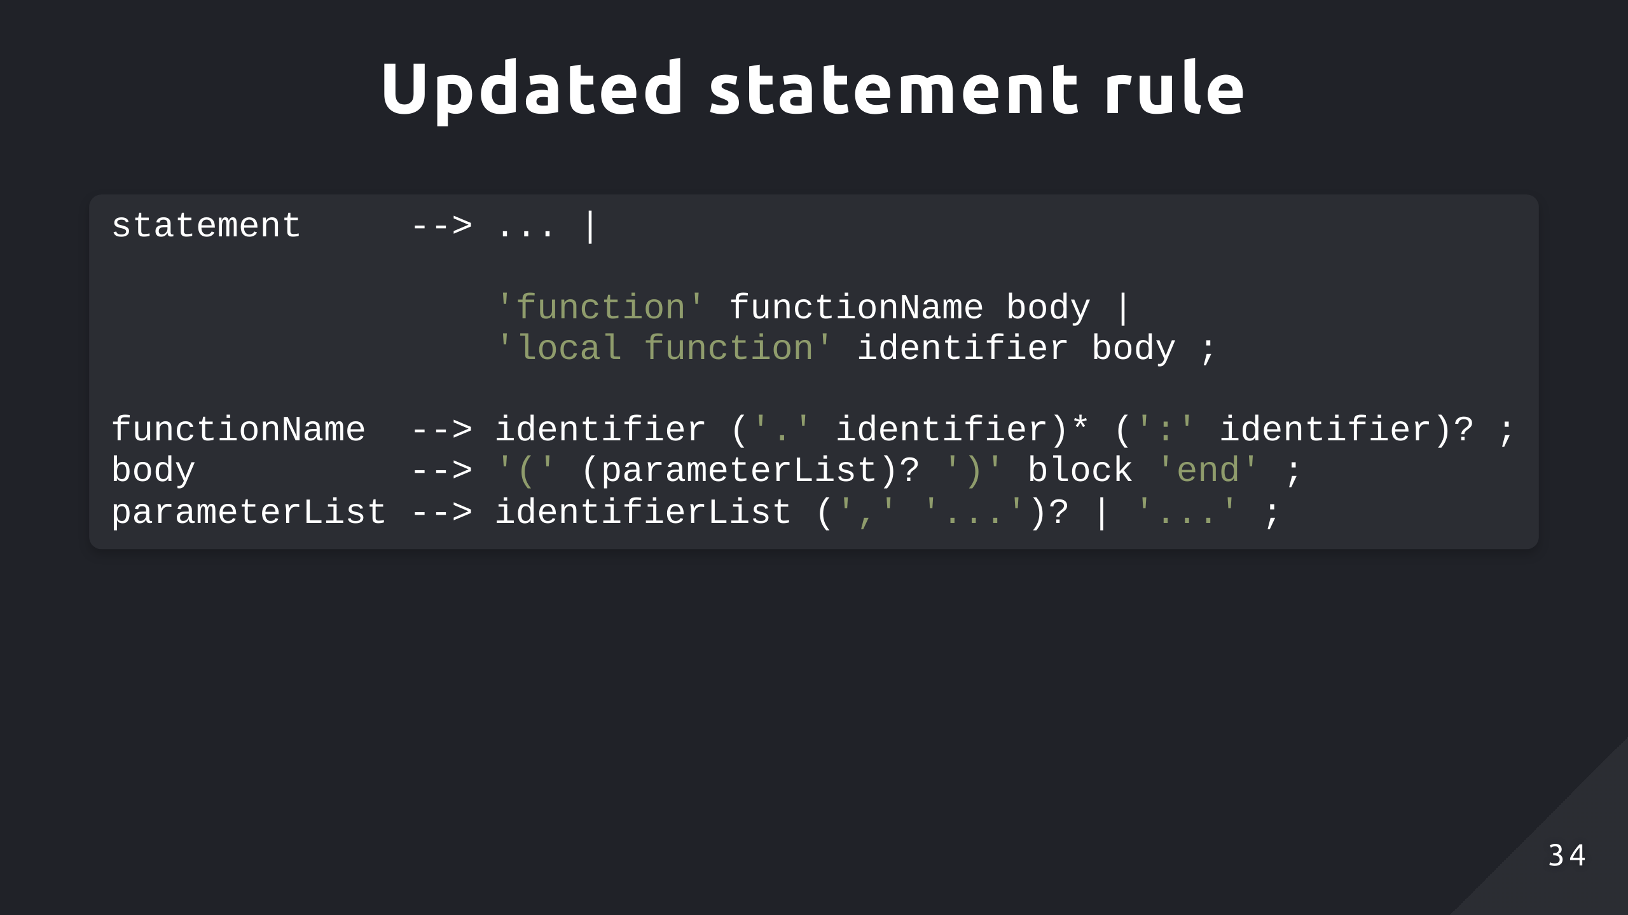

Slide 35
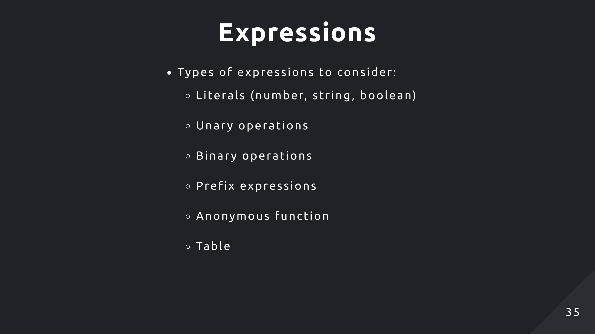

Slide 36
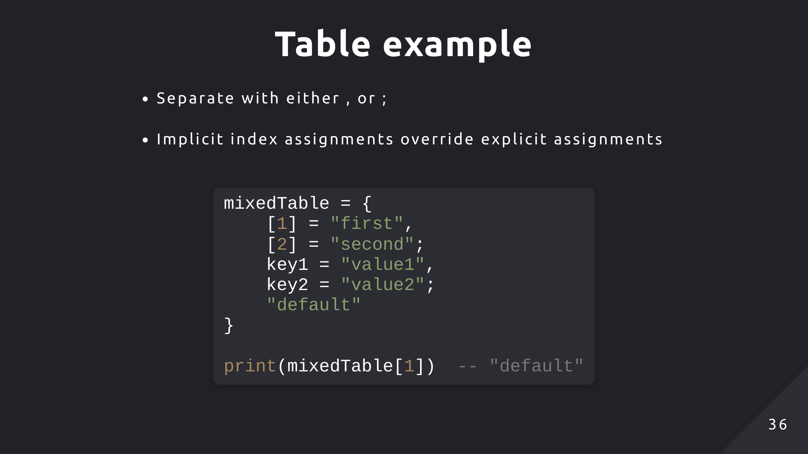
Notes:
Order doesn’t matter
Putting “default” first won’t change the outcome

Slide 37
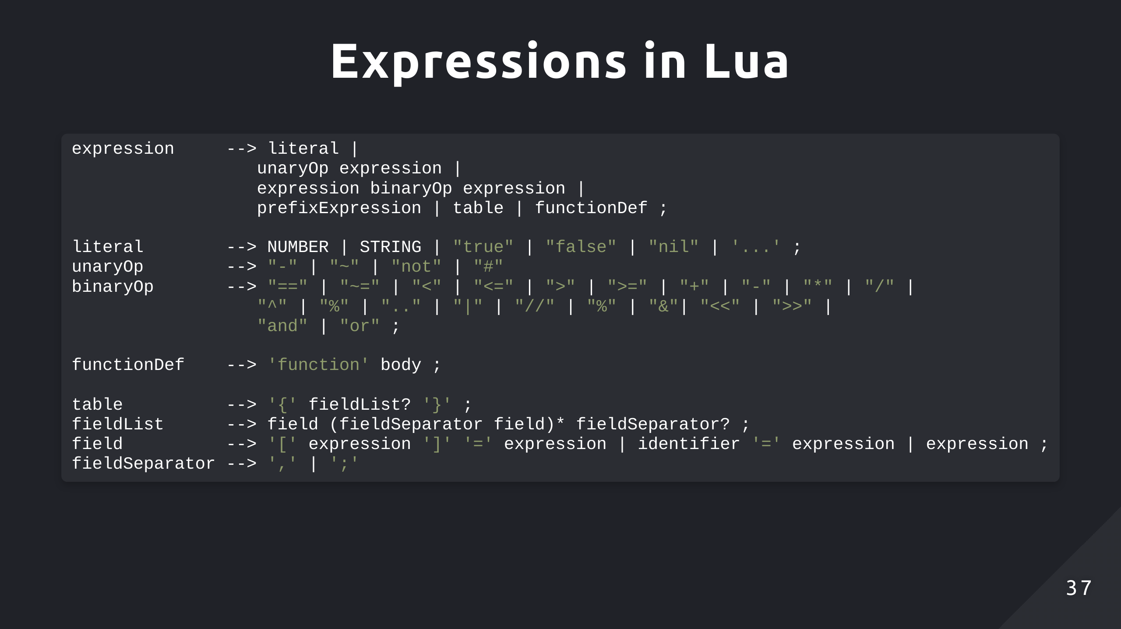

Slide 38
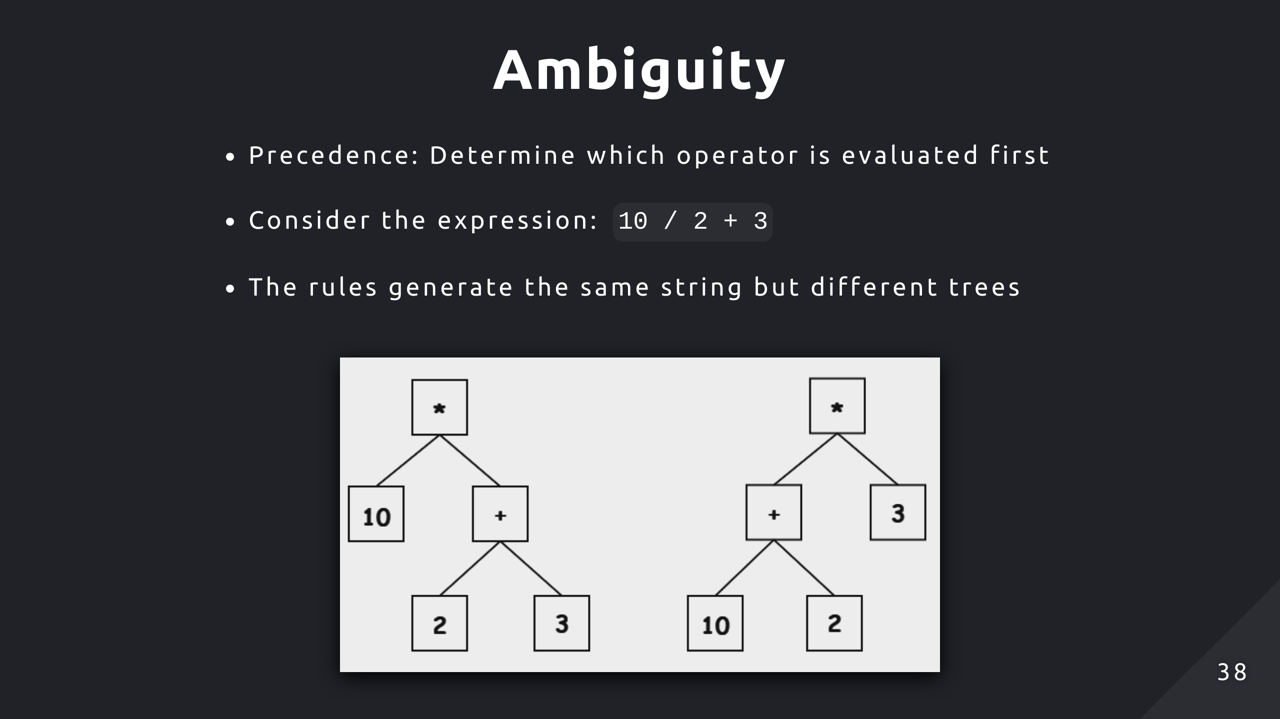
Notes:
It’s possible to generate the same string from combining different rules
Isn’t important for checking if string is a part of the language, but causes ambiguity for the parser

Slide 39
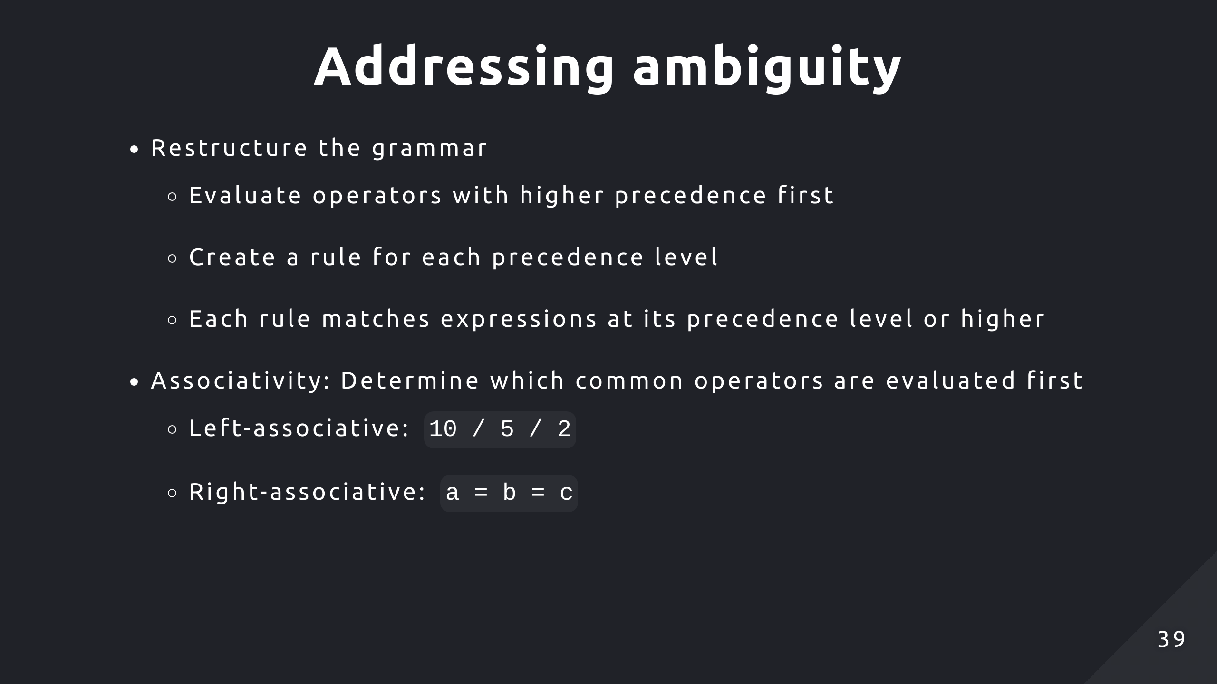

Slide 40
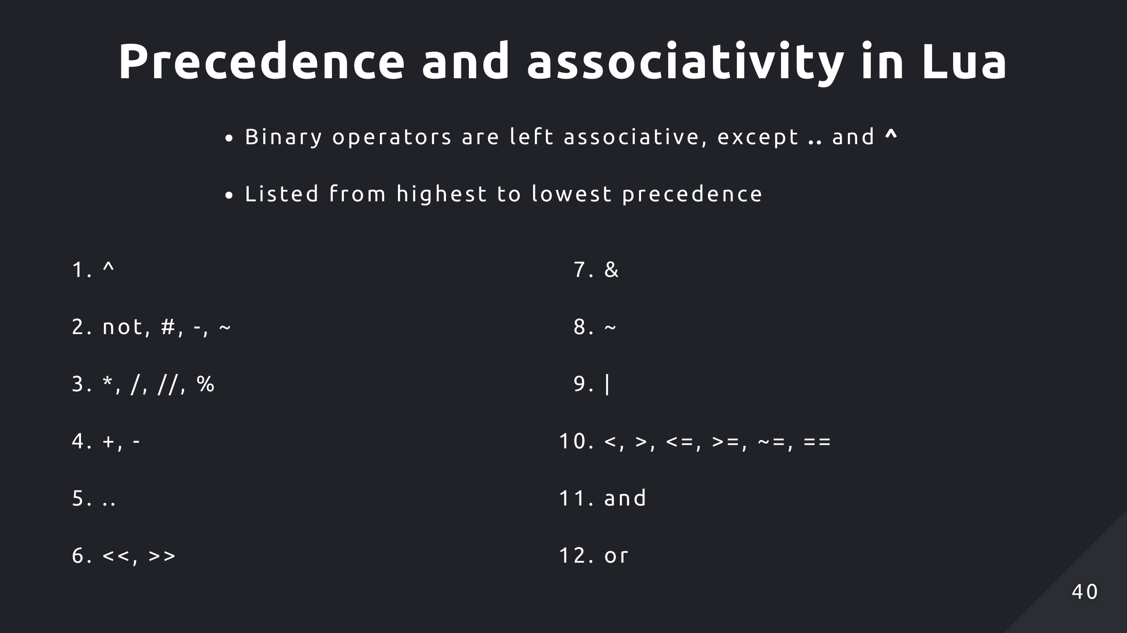
Notes:
Ex. Look at 3 and 4, multiplication / division have higher precedence than addition / subtraction

Slide 41
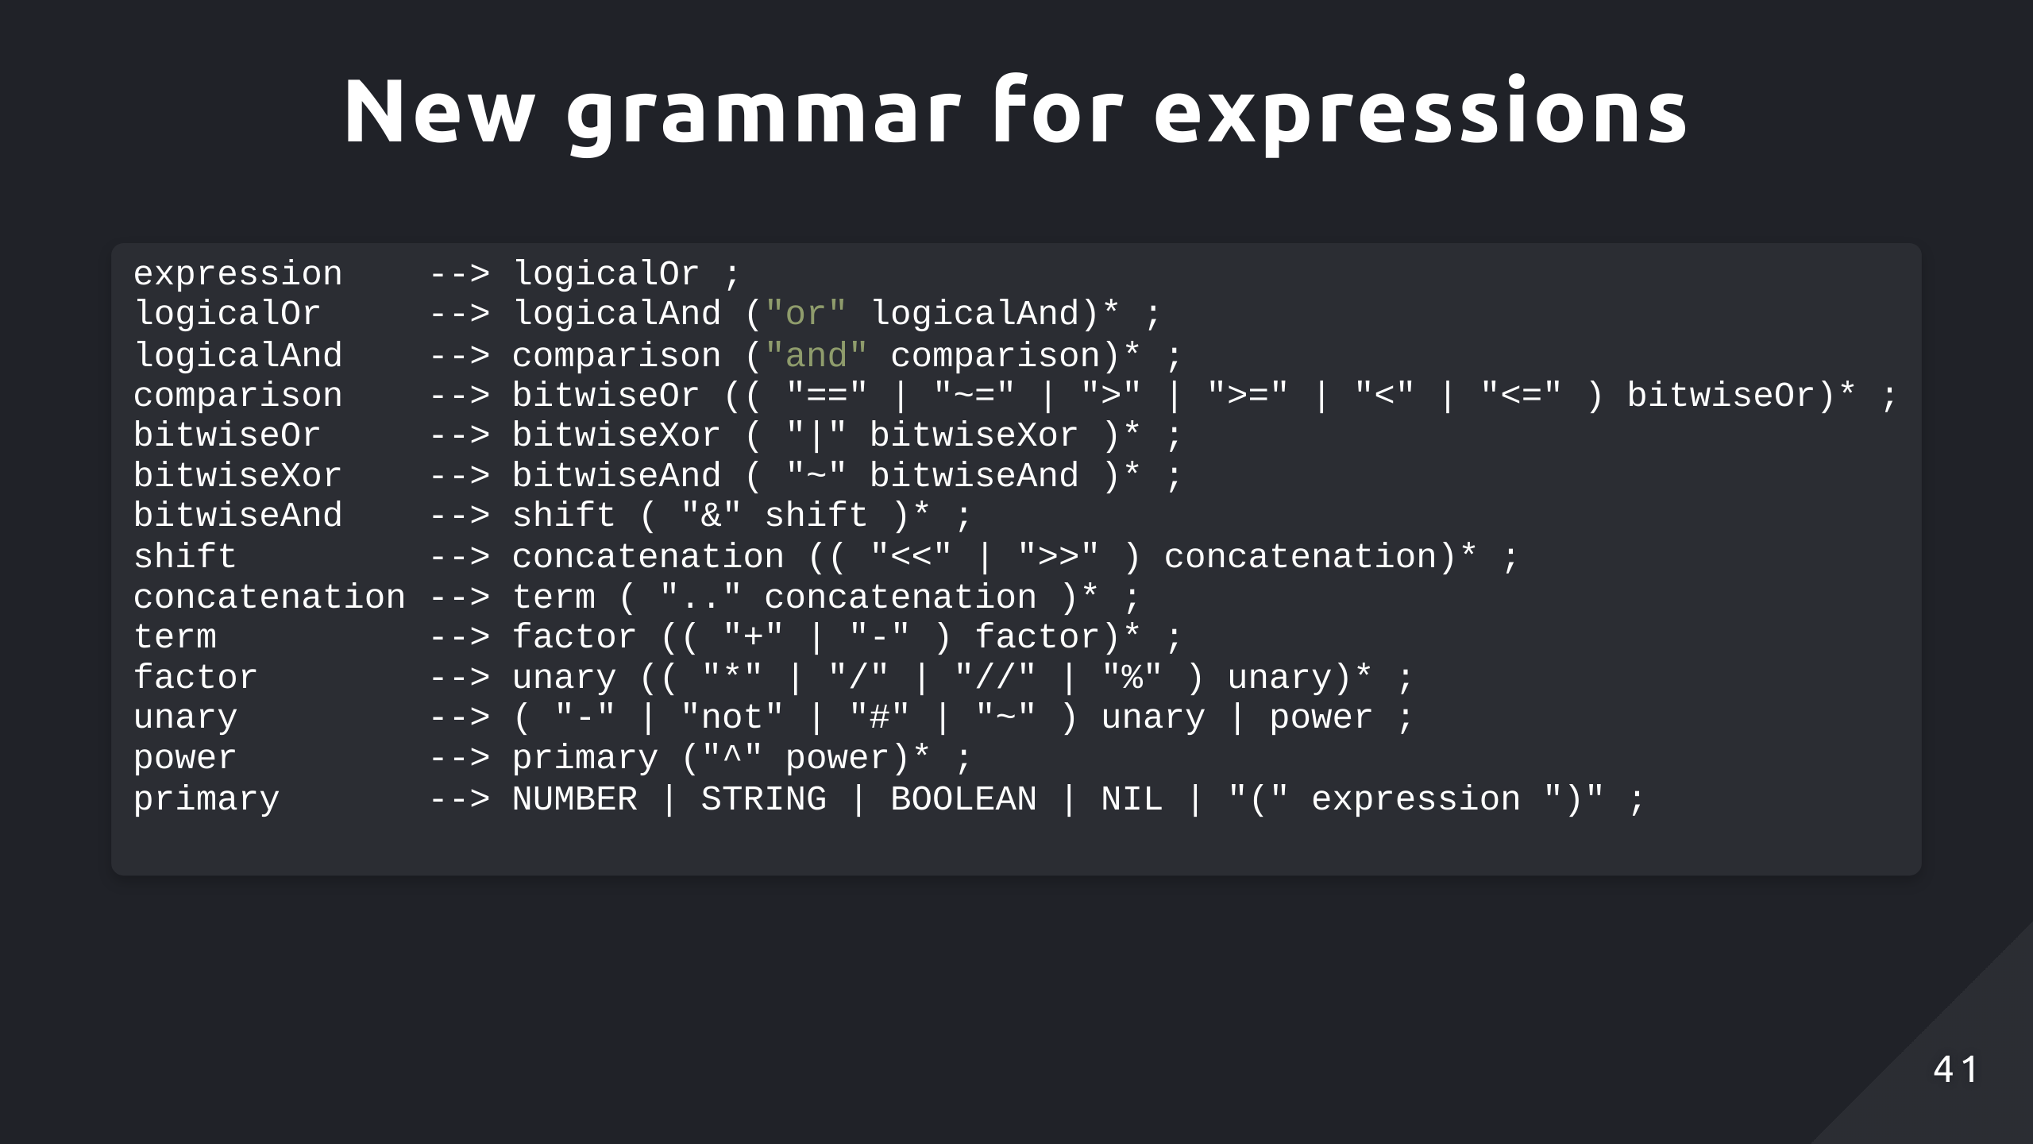
Notes:
Recursively parsing operands right to left allows the parser to evaluate the rightmost operation first
Demo:
(2 + 3) * 4 > 10
BitwiseOr > BitwiseOr
Unary * Unary
‘(‘ expression ‘)’
Factor + Factor

Slide 42
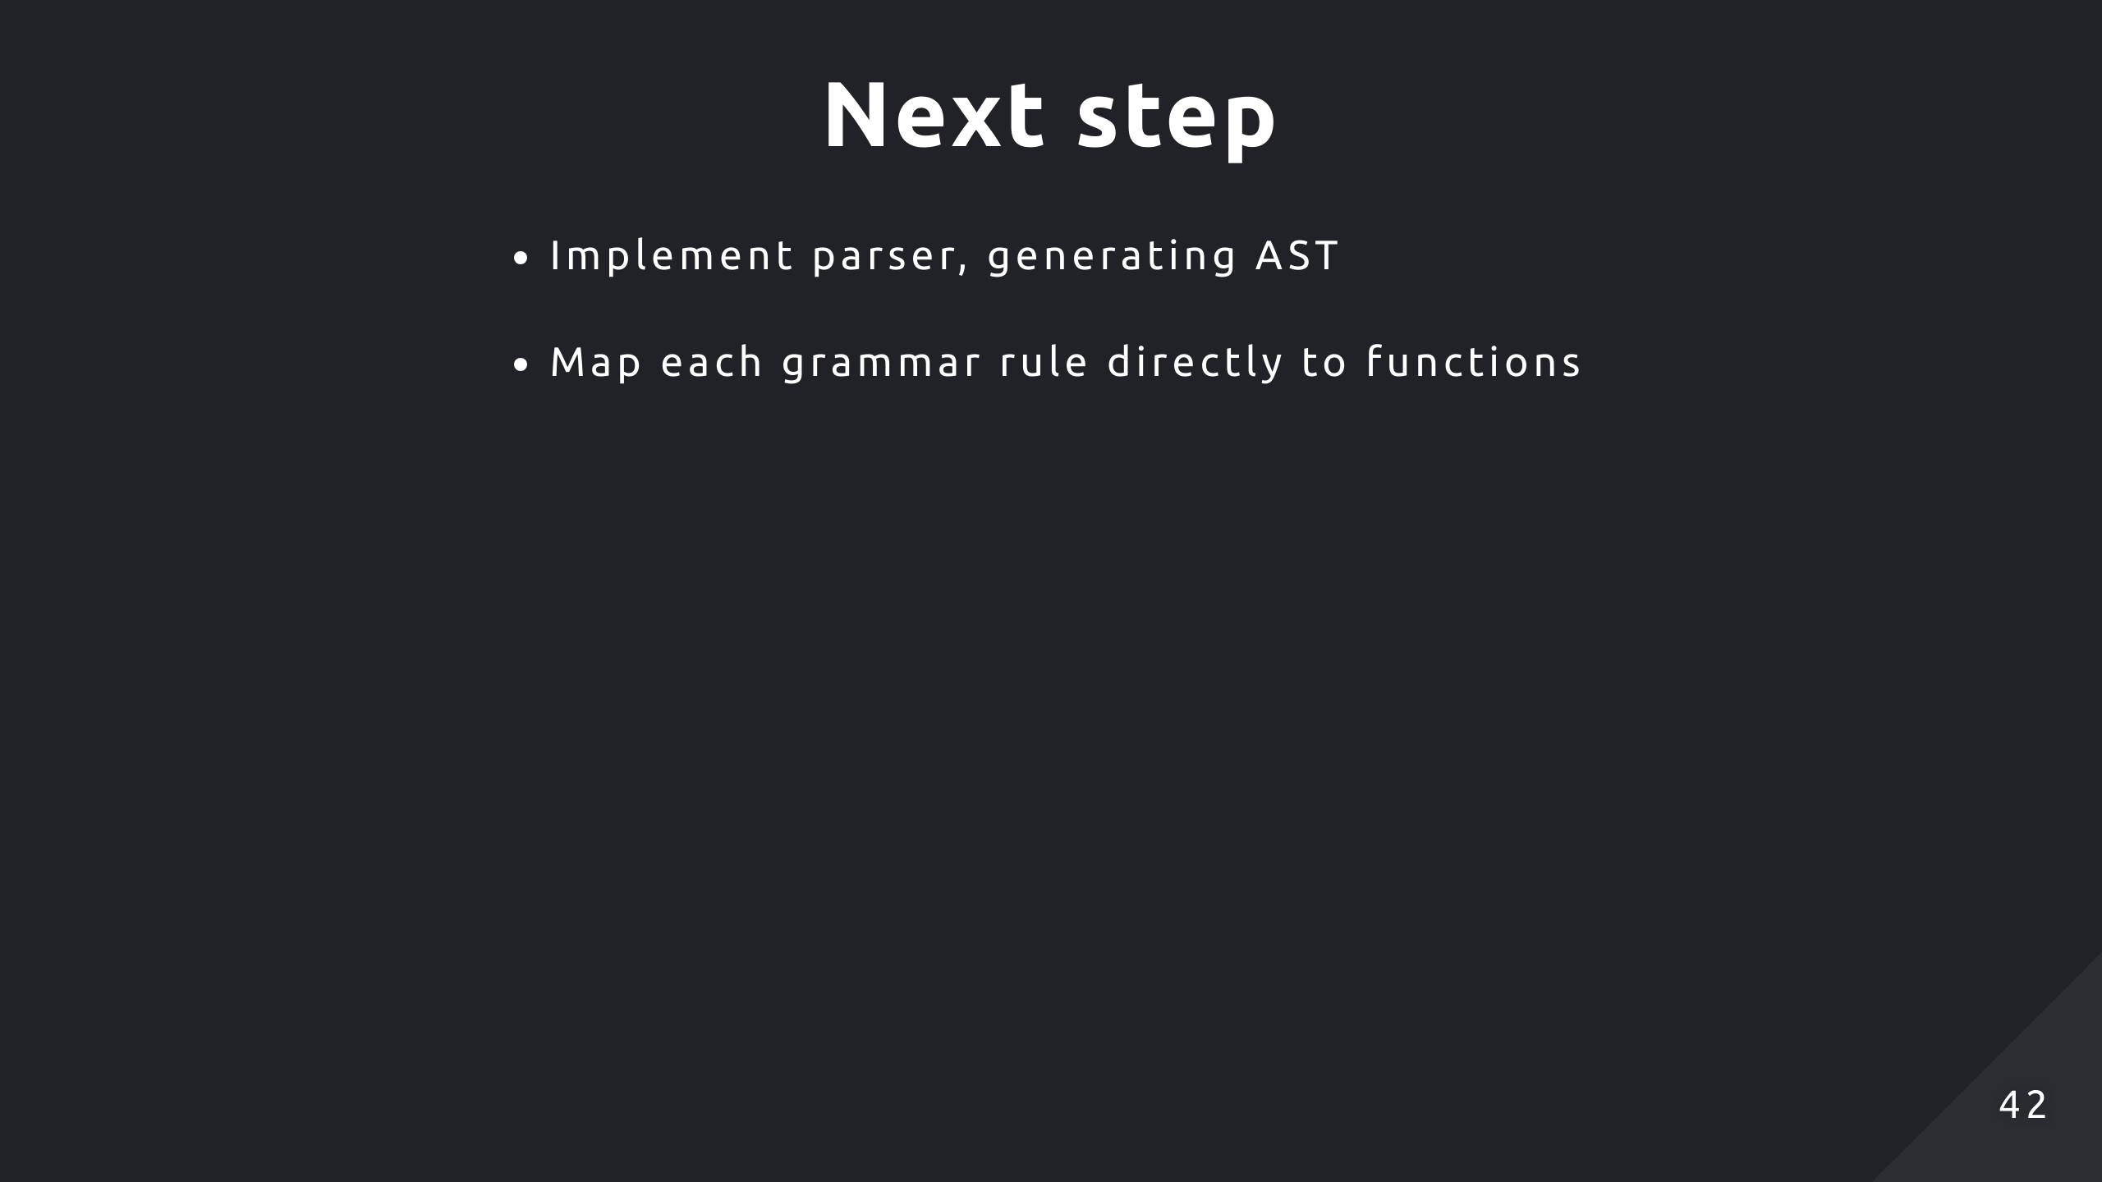

Slide 43
